Slide 1
A Collision of Crises:
The case for aligning future capital investment with the National Planning Framework, supporting a coordinated response to Dublin’s twin crises of housing & traffic
Cllr. William Lavelle
South Dublin County Council

Slide 2

“Since 2009, persistent under-supply, especially in Dublin, means that the housing supply deficit is likely to currently exceed 50,000 homes”
Cllr. William Lavelle
RSA Ireland Conference – 9th September 2016

Slide 3

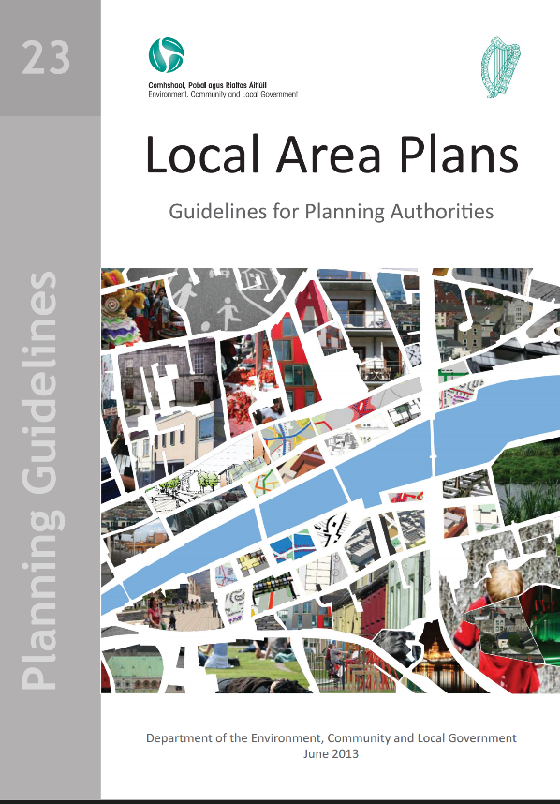
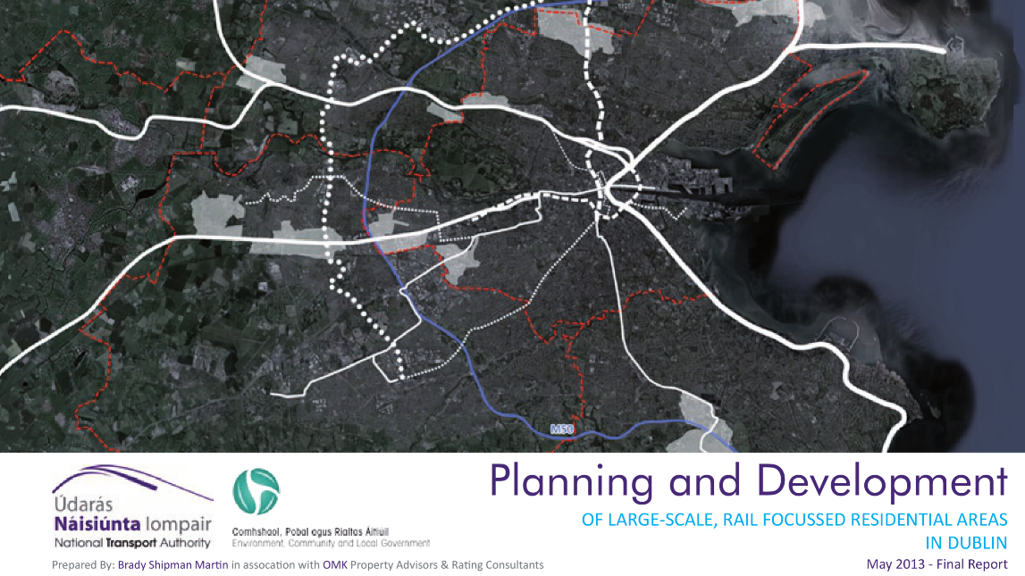
Cllr. William Lavelle
RSA Ireland Conference – 9th September 2016

Slide 4
National Transport Authority; Planning and Development of large-scale, rail focussed residential areas in Dublin; 2013
Cllr. William Lavelle
RSA Ireland Conference – 9th September 2016

Slide 5
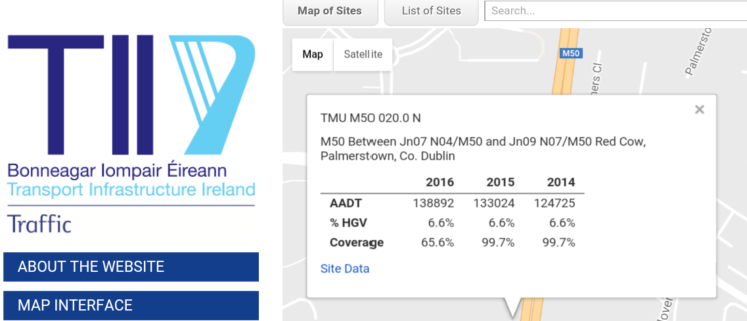
www.nratraffic.ie
Cllr. William Lavelle
RSA Ireland Conference – 9th September 2016

Slide 6
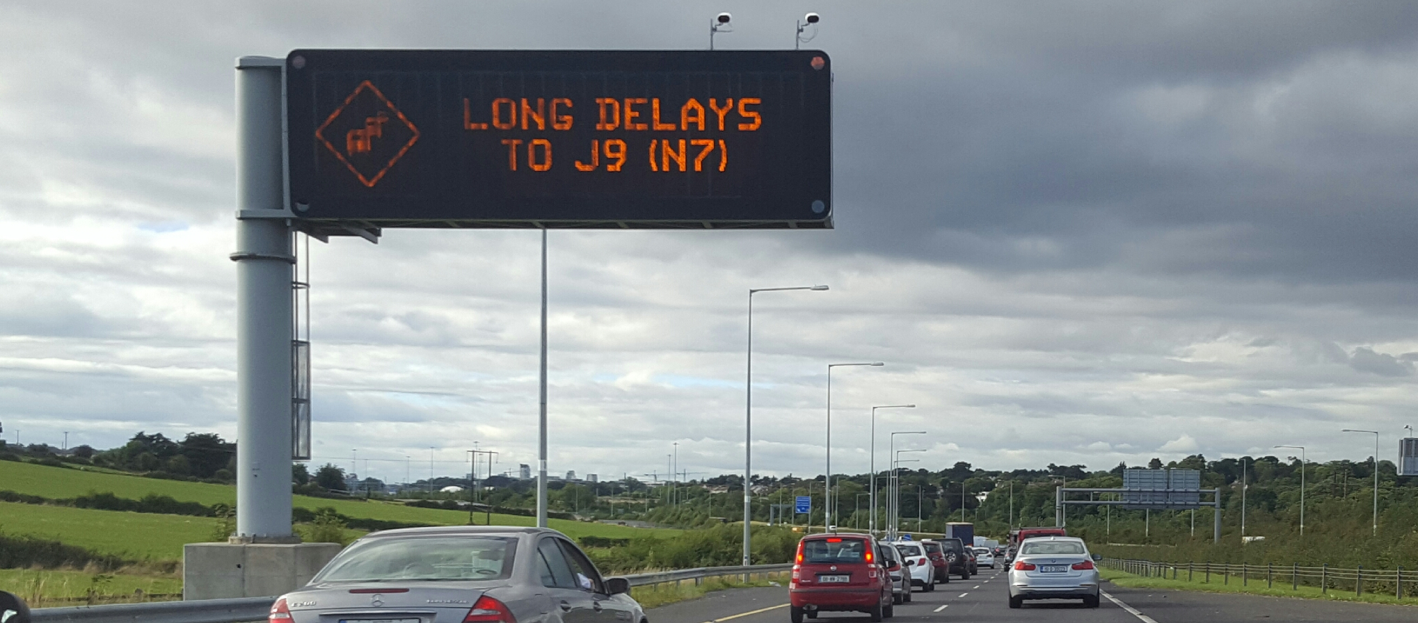
06/09/2016
Cllr. William Lavelle
RSA Ireland Conference – 9th September 2016

Slide 7
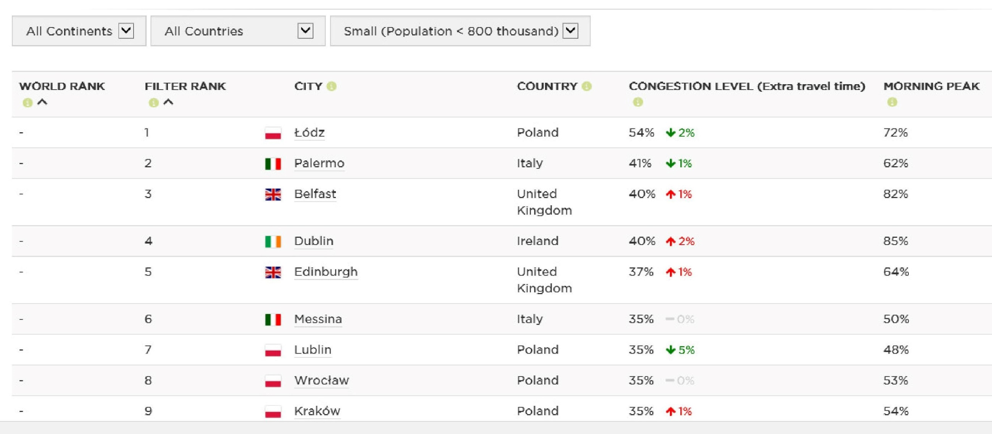

www. tomtom.com/en_ie/trafficindex
Cllr. William Lavelle
RSA Ireland Conference – 9th September 2016

Slide 8
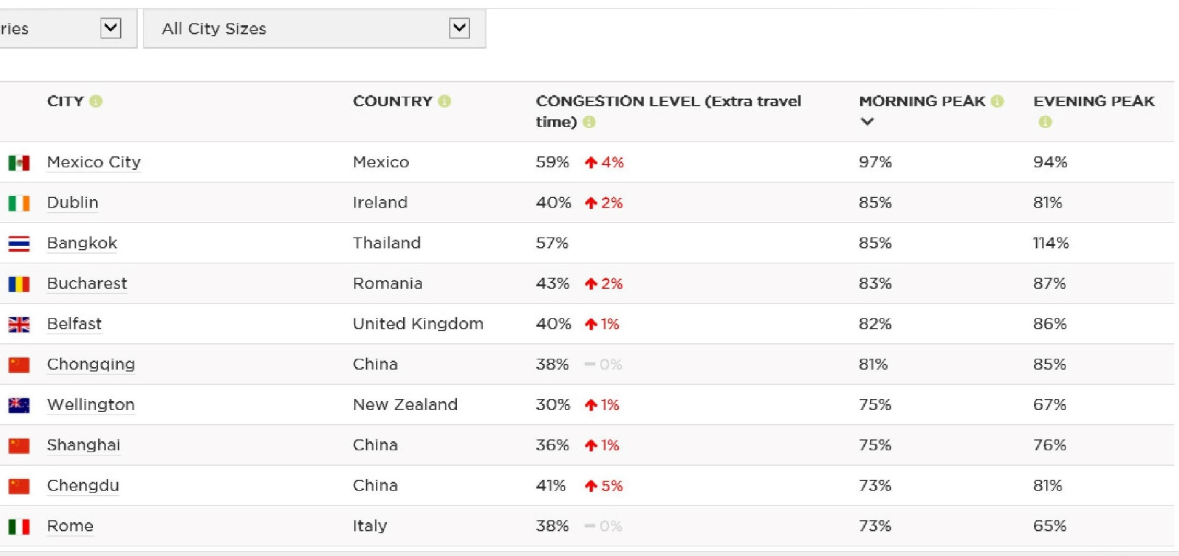
www. tomtom.com/en_ie/trafficindex
Cllr. William Lavelle
RSA Ireland Conference – 9th September 2016

Slide 9
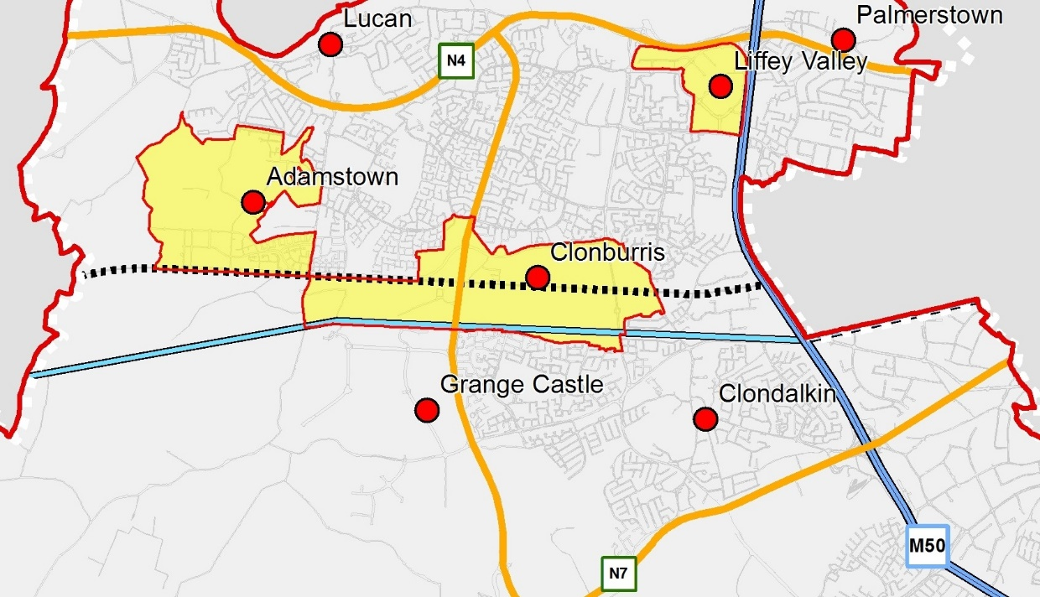
Courtesy of SDCC Mapping Office
Cllr. William Lavelle
RSA Ireland Conference – 9th September 2016

Slide 10
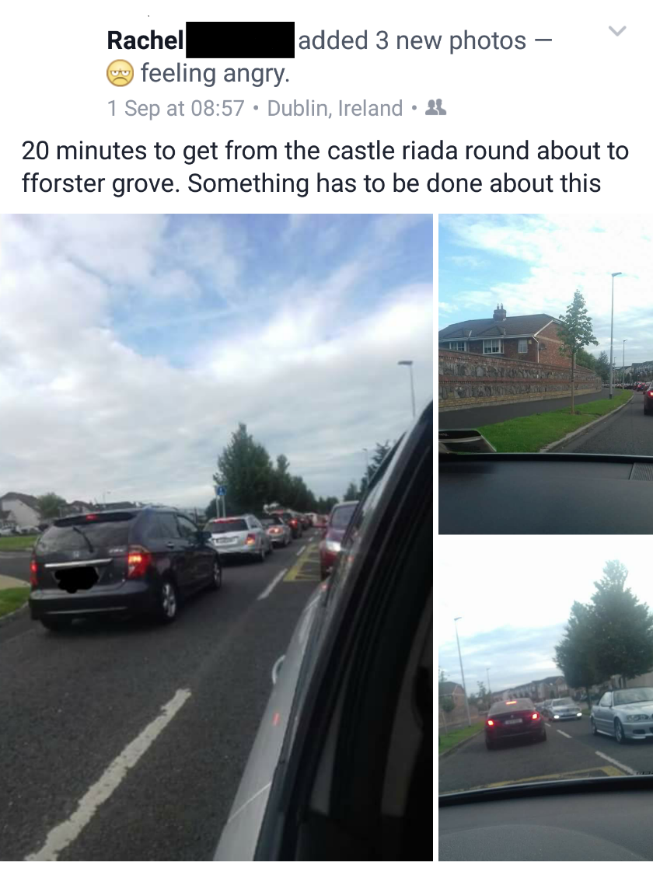
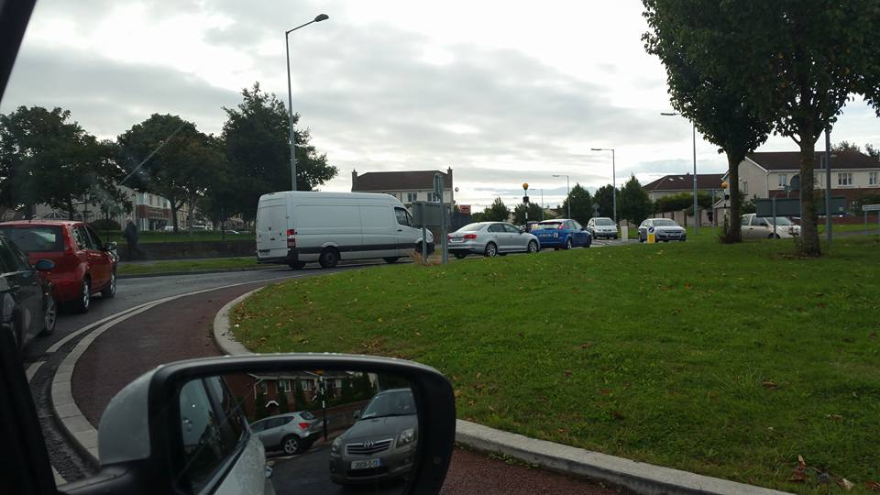
The traffic was back up to the Centra in Foxborough at 8.20 the other morning. I was late for my kids first day back.
Sinead
There should also be another 25A/B between the 6:46 and 7am and 7:10, at least two of these are full by the time they reach Willsbrook each morning. Even the bus drivers are frustrated and often come on the PA urging us to raise the issue.
Vincent
I have already been stuck at roundabout (feeding onto to Castle Road) for 20 mins… Joanne
The last two mornings were the worst I've seen it… Shirley
Cllr. William Lavelle
RSA Ireland Conference – 9th September 2016

Slide 11
“Ambitious interventions are likely to be required to provide the additional public transport capacity and to encourage the behavioural change necessary if reduced level of car use is to be achieved. Without this, the Authority would have concerns that the development quanta and form envisaged by SDCC could not be constructed without compromising the strategic role of the national roads…”
National Roads Authority; Pre-draft submission on SDCC Development Plan; October 2014
Cllr. William Lavelle
RSA Ireland Conference – 9th September 2016

Slide 12
A more coordinated response?
Increase public transport carrying capacity
Transport strategies & public transport services to include surrounding areas.
Address road capacity constraints
Housing
Supply
Transport Capacity
Integrated land-use and transport planning will require both harder edged policy and investment
Cllr. William Lavelle
RSA Ireland Conference – 9th September 2016

Slide 13
Cllr. William Lavelle
RSA Ireland Conference – 9th September 2016

Slide 14
Cllr. William Lavelle
RSA Ireland Conference – 9th September 2016

Slide 15
Action 42:
“The NPF and the proposed Regional Spatial and Economic Strategies will be developed to include a robust infrastructure investment and delivery programme linked to the public spending review cycles of the Department of Public Expenditure and Reform and the investment programmes of all relevant infrastructure agencies…”
Construction 2020, A Strategy for a Renewed Construction Sector, May 2104
Cllr. William Lavelle
RSA Ireland Conference – 9th September 2016

Slide 16
Opportunity for Alignment?
Link mid-term Capital Review to NPF
Strengthen the statutory basis for the NPF
Obligation that capital investment programmes must adhere with the NPF
New Oireachtas Committee on Planning & Infrastructure?
Cllr. William Lavelle
RSA Ireland Conference – 9th September 2016

