Slide 1
Specialisation, Diversity and Sector Employment Patterns of Irish Regions
Seán O’Connor & Eleanor Doyle
School of Economics,
University College Cork,
Ireland

Slide 2
Introduction
The increasing interest relating to regional growth over the last two decades has meant a wide-ranging debate has developed around the topic of regional disparities across the European Union (Borys et al., 2008; Marelli & Signiorelli, 2010a).
In more recent times it would appear that although disparities (in income terms) have declined between countries, disparities within regions have increased (Doran & Jordan, 2013).
Action Plan for Jobs – Regional
Best way to support job creation in towns and villages across the country is to support agencies and organizations within each region to build on the particular strengths and assets of their area and drive new job-creation strategies and projects.
The primary objective of these plans is to have a further 10 to 15 per cent at work in each region by 2020 and to ensure the unemployment rate of each region is within one per cent of the State average.

Slide 3
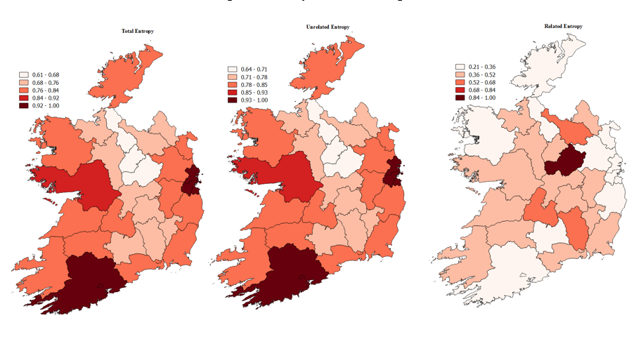
Over the period 2006-2012 found diversification to be a positive impact on employment amongst Irish regions.
Relatedness was beneficial to employment, having a broad range of sectors was more conducive to lessening the impact of the economic downturn.

Slide 4
Diversity vs Specialisation?
Amongst academics debate has raged as to whether specialization or diversity is most conducive to local growth (Cingano and Schivardi, 2004).
Diverse regions are more protected from volatility of the business cycle, thus better equipped to avoid large fluctuations in employment (Hackbart and Anderson,1975; Dissart, 2003).
Jacobian externalities.
Regional specialisation may enable employment growth as firms not only compete but cooperate with each other for scarce resources.
MAR externalities.
We wish to examine how various externalities can influence sectoral employment patterns.
More an analysis of resilience than growth given the time period under consideration.

Slide 5
Theoretical framework
Based on the model presented in Bishop and Gripaios (2010)
Based of Glaeser et al. (1992) work.
Chosen due to lack of information on local capital inputs.
Assumptions.
Assume that wage growth and technological growth is homogenous across Irish regions.
Employment growth can be explained by various externalities and competitive effects.
MAR externalities.
Jacobs externalities.
Urbanisation economies.
Local competition.

Slide 6
Externalities and employment patterns
26 2-digit NACE sectors from 2006-2012.
Regional Characteristics
Unrelated Variety – Share of NACE 2-digit cat in region i for time period t.
Related Variety – Share of NACE 4-digit cat within each 2-digit sector in region i for time period t.
Location Quotient – Proportion of regional employment in the sector relative to total regional employment/Proportion national employment in the sector relative to total national employment.
Competition – Proportion of micro firms in a region relative to the national average. (<10).
Population Density – Proxy for Urbanisation Economies.
Utilise a fixed effects estimator in all cases.
(1)

Slide 7
26 2-digit sectors

Slide 8
Overview of results
Most models presented a reasonable level of fit.
(1, 10, 26, 55, 64, 81, 86).
Six cases unbalanced panel.
(26, 32, 64, 78, 84, 87).
Most consistent impact is that of specialisation.
Positive and significant in all but one case.
Large in (43,62,84,88,96).
Competition variable is significant in only three cases.
+ (32), - (58,86).
Unrelated Variety is significant in 13 cases.
Agri, Industry and Distribution: + 5, - 1.
Business Services:+ 3, -1.
Personal Services: -3.
Related Variety significant in 12 cases.
Inconsistent sign across sectors.
+(1, 43, 55, 62, 68) – (10, 32, 41, 46, 49, 56, 86, 96).
Population Density significant in 24 cases.
Positive effect in five sectors with the remainder negative.

Slide 9
Agriculture, Industry and Distribution
 | Sector
 | 1 | 10 | 26 | 32 | 41 | 43 | 45 | 46 | 49
Constant | 9.854*** (0.473) | 10.185*** (0.403) | 25.031*** (1.886) | 6.539*** (0.264) | 40.963*** (5.588) | 39.276*** (3.055) | 14.460*** (1.497) | 14.364*** (0.805) | 10.553*** (0.695)
Unrelated Variety | 1.687* (0.016) | 0.048 (0.614) | 6.041** (2.153) | -1.579*** (0.166) | 6.761** (2.583) | 6.733** (2.443) | 1.745* (1.011) | 1.295 (1.046) | 0.785 (0.645)
Density | -0.654*** (0.143) | -0.899 (0.098) | -4.253*** (0.419) | -0.180** (0.068) | -8.300*** (1.361) | -7.635*** (0.793) | -1.895*** (0.399) | -1.680*** (0.180) | -1.023*** (0.154)
Location quotient | 0.480*** (0.133) | 0.943*** (0.016) | 1.025*** (0.058) | 0.994*** (0.005) | 0.248 (0.557) | 1.211** (0.578) | 0.708** (0.318) | 0.745** (0.135) | 0.792*** (0.079)
Competition | 1.960 (2.641) | 0.017 (0.033) | 0.141 (0.166) | 0.041** (0.017) | -0.758 (2.099) | 0.116 (7.008) | -1.050 (0.792) | -0.231 (0.505) | -0.401 (0.542)
Related variety | 0.836*** (0.109) | -0.098*** (0.027) | -0.080 (0.063) | -0.034*** (0.008) | -0.589** (0.246) | 4.008*** (1.358) | 0.367 (0.302) | -0.477 (0.382) | -0.500*** (0.105)
R² | 0.066 | 0.054 | 0.023 | 0.658 | 0.190 | 0.193 | 0.370 | 0.319 | 0.245
F | 59.24 | 1194.97 | 285.07 | 12421.05 | 63.74 | 39.10 | 51.32 | 39.44 | 115.05
P>F | 0.000 | 0.000 | 0.000 | 0.000 | 0.000 | 0.000 | 0.000 | 0.000 | 0.000
n | 189 | 189 | 127 | 181 | 189 | 189 | 189 | 189 | 189
Notes: ***, **, *, Indicates significance at the 1%, 5% and 10% level; figures in brackets are Robust SEs, R² is overall R².

Slide 10
Business Services
 | Sector
 | 62 | 64 | 66 | 68 | 69 | 71 | 78 | 81
Constant | 2.800*** (0.542) | 11.558*** (0.479) | 4.751*** (0.521) | 9.790*** (0.483) | 10.920*** (0.644) | 21.125*** (1.489) | 11.786*** (1.210) | 9.081*** (0.613)
Unrelated Variety | -1.281* (0.662) | -0.377 (0.540) | 1.081** (0.475) | 0.213 (0.606) | 0.578 (0.665) | 4.136*** (1.380) | 3.230** (1.270) | 1.661 (1.309)
Density | 0.835*** (0.145) | -1.170*** (0.115) | 0.422 (0.126) | -0.917*** (0.117) | -1.037*** (0.157) | -3.539*** (0.384) | -1.200*** (0.301) | -0.580*** (0.142)
Location quotient | 1.029*** (0.059) | 0.998*** (0.018) | 0.904*** (0.037) | 0.958*** (0.074) | 0.794*** (0.183) | 0.843*** (0.230) | 0.945*** (0.026) | 0.939*** (0.068)
Competition | 0.538 (0.358) | 0.057 (0.058) | 0.116 (0.083) | -0.230 (0.509) | -0.537 (0.362) | 1.476 (1.517) | -0.073 (0.057) | -0.497 (0.668)
Related variety | 0.221*** (0.072) | -0.002 (0.012) | 0.067 (0.040) | 0.097* (0.055) | -0.247 (0.665) | 0.238 (0.286) | -0.025 (0.023) | 0.048 (0.068)
R² | 0.795 | 0.008 | 0.820 | 0.204 | 0.327 | 0.267 | 0.238 | 0.131
F | 132.88 | 762.80 | 223.52 | 118.27 | 25.83 | 25.68 | 924.47 | 62.94
P>F | 0.000 | 0.000 | 0.000 | 0.000 | 0.000 | 0.000 | 0.000 | 0.000
n | 189 | 187 | 189 | 189 | 189 | 189 | 166 | 189
Notes: ***, **, *, Indicates significance at the 1%, 5% and 10% level; figures in brackets are Robust SEs, R² is overall R².

Slide 11
Personal Service
 | Sector
 | 47 | 55 | 56 | 84 | 85 | 86 | 87 | 88 | 96
Constant | 11.616*** (0.428) | 13.923*** (0.592) | 10.925*** (0.512) | 2.550*** (0.687) | 5.916*** (0.672) | 11.595*** (2.398) | -7.580*** (1.880) | -1.706 (1.365) | 9.844*** (0.380)
Unrelated Variety | 0.554 (0.618) | 0.002 (0.682) | 0.507 (0.671) | -1.977*** (0.537) | -1.671 (0.195) | -1.715* (0.951) | -3.038 (2.050) | -3.216** (0.522) | 0.246 (0.651)
Density | -0.804*** (0.102) | -1.761*** (0.149) | -0.837*** (0.122) | 1.260*** (0.191) | 0.399** (0.171) | -1.324** (0.597) | 3.366*** (0.515) | 2.052*** (0.356) | -0.902*** (0.082)
Location quotient | 0.740*** (0.211) | 0.904*** (0.079) | 0.669*** (0.122) | 1.020*** (0.037) | 0.937*** (0.022) | 0.432*** (0.072) | 0.550*** (0.209) | 1.061*** (0.084) | 1.033*** (0.024)
Competition | 0.526 (0.742) | -0.152* (0.077) | -0.271 (0.358) | -0.054 (0.052) | 0.090 (0.192) | -1.458* (0.841) | 0.022 (0.076) | 0.155 (0.109) | 0.065 (0.486)
Related variety | -0.013 (0.285) | 0.110*** (0.010) | -0.408*** (0.103) | -0.021 (0.018) | 0.011 (0.040) | -0.913*** (0.097) | -0.183 (0.142) | 0.105 (0.118) | -0.117** (0.059)
R² | 0.299 | 0.091 | 0.265 | 0.627 | 0.552 | 0.033 | 0.201 | 0.399 | 0.279
F | 22.31 | 147.52 | 26.61 | 210.19 | 1301.28 | 301.36 | 33.69 | 163.92 | 453.06
P>F | 0.000 | 0.000 | 0.000 | 0.000 | 0.000 | 0.000 | 0.000 | 0.000 | 0.000
n | 189 | 189 | 189 | 185 | 189 | 189 | 179 | 189 | 189
Notes: ***, **, *, Indicates significance at the 1%, 5% and 10% level; figures in brackets are Robust SEs, R² is overall R².

Slide 12
Comparison with other studies
Specialisation: + in contrast to work by Combes (2000) – France, Deidda et al. (2006) – Italy, Bishop and Gripaios (2010) – Great Britain.
Local Competition: Bishop and Gripaios (2010) + , Combes – where significant
Deidda et al. (2006) generally inconsistent, and generally insignificant.
Unrelated Variety – generally insignificant
Frenken et al. (2007) UE unlikely to generate employment growth.
Combes (2000), Deidda et al. (2006), Bishop and Gripaios (2010) generally has a negative or insignificant impact on employment.
Eight sectors were it is significant so it’s not exactly homogenous.
Related Variety – heterogeneous impact across sectors.
Bishop and Gripaios (2010) - noted related variety as only significant in four sectors, with a similar inconsistency in terms of the sign.
Pop Density – heterogeneous impact.
Generally insignificant in Bishop and Gripaios (2010) with a similar pattern found in Combes (2000) and Deidda et al. (2006).

Slide 13
Limitations
Time period is impacted by a sharp downward trend in employment across Ireland.
Conventional relationships may be consistent in stable period.
Specialisation significant – why?
Measurement issue?
We use levels.
Cross section utilise percent change from 2006-2012 (see Bishop and Gripaois, 2010).
Need a larger n.
Lack of spatial disaggregation available.
Business Demography 34 spatial units.
UK’s National On-line Manpower Information System (203 areas).
Deidda et al. (2006) – 784 Local Labour Systems.
Van Soest et al. (2006) – 416 zip code areas.

