Slide 1
European Perspectives and National Cases Peter Mehlbye
Planning for Regional Development
National Planning Framework – Roadmap for Irelands future?
RSA Conference in Galway, 9 September 2016

Slide 2
Structure
Game changers and European policy dynamics
Visions for the European territory towards 2050
Irish challenges and opportunities
National cases of inspiration:
Denmark
Latvia
Reflections on the NFP

Slide 3
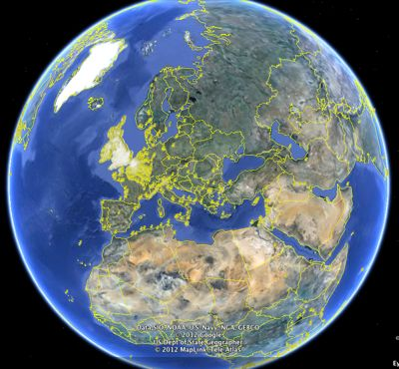
Game changers
Key mega trends influencing European space
Global context
Digital revolution
Demographic dynamics
New life style preferences

Slide 4
European policy challenges
Key challenges for the European policy process
Brexit implementation
Economic growth and jobs
Keeping the European Union as a strong global player
Climate change and sustainable development
Ageing, migration and refugee flows
Social exclusion and growing income gaps
Increasing regional imbalance following the crisis
Territorial concentration forces
Regional convergence replaced by divergence
Growth of larger urban regions
Decline in many rural areas creating inner peripheries

Slide 5
European Territorial Vision and Scenarios 2050
Territorial Vision 2050 – a reference?
“An Open and Polycentric Territory of the European Union”
3 territorial scenarios:
Scenario A
Scenario B
Scenario C

Slide 6
Comparing territorial scenarios A, B and C
Towards 2030, scenario B is the most expansionary in terms of GDP.
Baseline: + 1,9%
Scenario A: + 2,2%
Scenario B: + 2,3%
Scenario C: + 1,8%
B: Highest levels of territorial cohesion and competitiveness.
Regional divergence is only marginally reduced.
Towards 2050, European economic growth is not significantly affected by the promotion of any of the 3 territorial scenarios
A polycentric and balanced European territory: Possible policy option for a long-term territorial vision 2050.
Evolutionary process recommended: Gradually unleashing growth potential delivers highest overall economic growth with least environmental impact, transport and energy demand

Slide 7
Possible evolution of the European Territory towards 2020

Slide 8
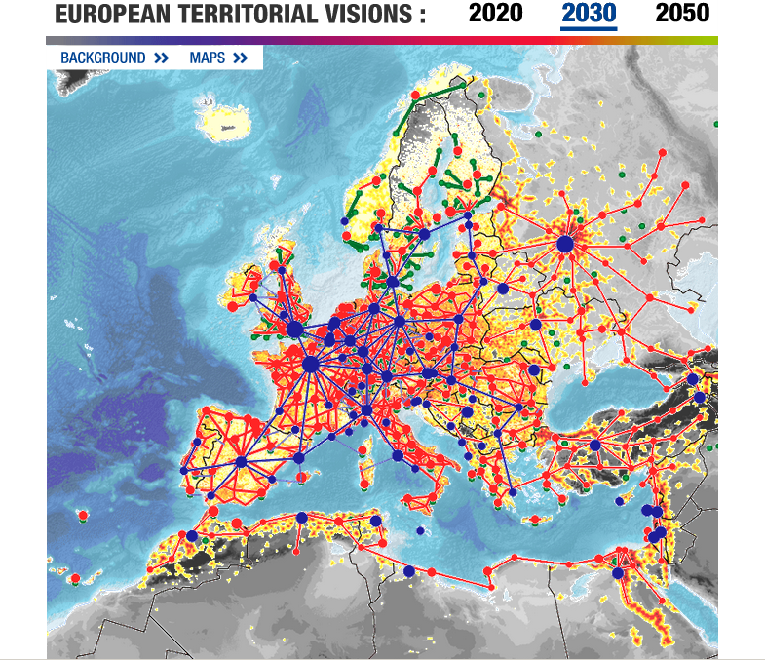
Possible evolution of the European Territory towards 2030

Slide 9
Possible evolution of the European Territory towards 2050

Slide 10
Irish challenges and opportunities (1)
Major challenges and opportunities
Make the most out of a Brexit
Trade volume and links to the UK
Investment space for USA, Canada and other English language oriented foreign investors and services
Transport connections and flows to EU Single market
New external EU border to Northern Ireland?
Highest economic growth rates in Europe
Positive population prospects, however still brain drain emigration to reverse
Current refugee crisis with little impact
Housing shortage
Counter climate change impacts
Ensure sustainable development
Use renewable energy potential and meet targets

Slide 11
Irish challenges and opportunities (2)
Territorial challenges and opportunities
Balance territorial concentration forces
Build on regional/city/county potentials
Develop the entire country
Promote urban drivers and cooperation at all scales
The capital Dublin as international metropolis
Larger cities stimulating cooperation arrangements creating polycentric functional regions
Towns connected to larger cities and cooperating
Rural territories included in functional regions
Balance the allocation of new housing in support of planning priorities and development potentials
Pay special attention to increasing inner peripheries
Address marine reality with spatial planning
Preserve natural, cultural and landscape assets important for long term sustainable development and attractivity

Slide 12
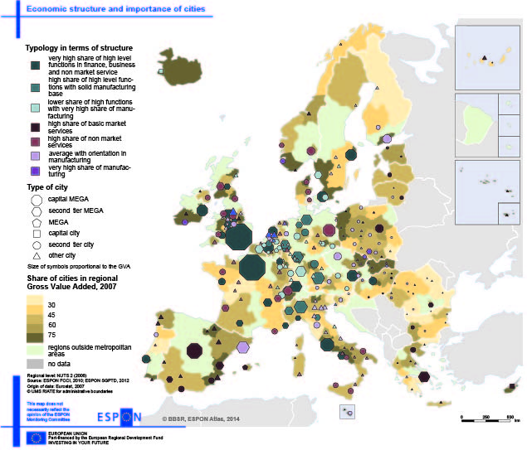
European structure and importance of cities

Slide 13
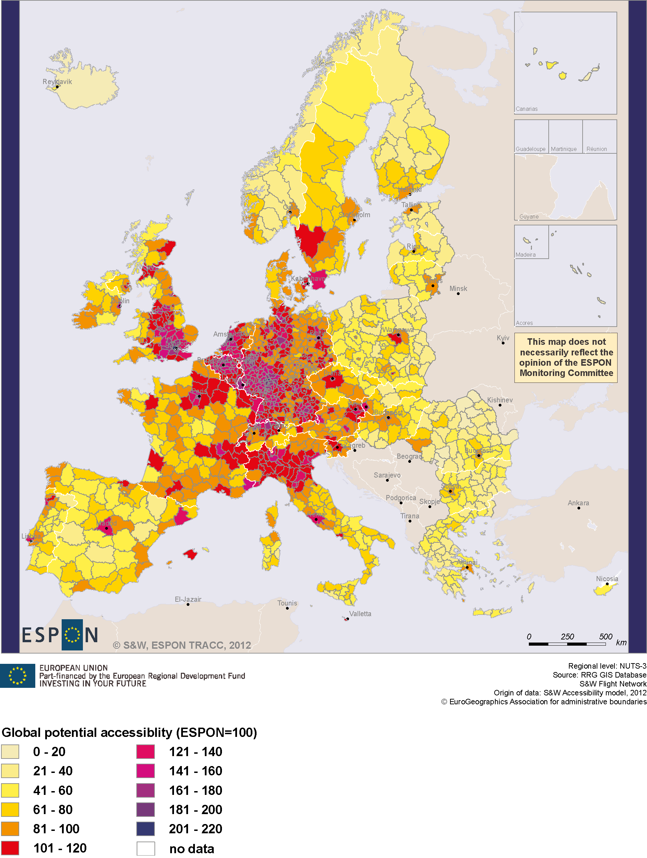
Global potential accessibility, 2012
Global potential accessibility in terms of options for travel world-wide:
The central part of the European territory is best connected internationally, while other countries in general have weaker global accessibility
Capital regions in general stand out in terms of access to international destinations
Intercontinental sea borne connections heavily concentrated around the Channel

Slide 14
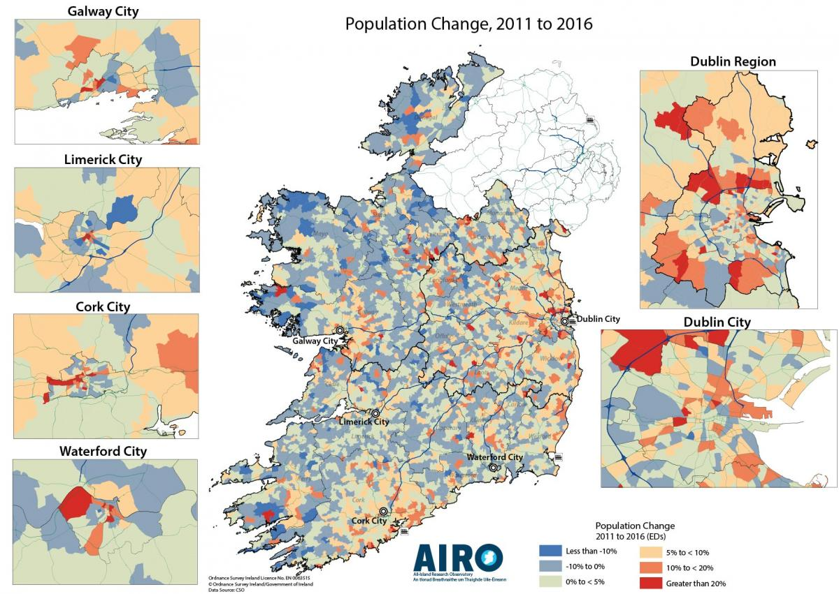
Irish population dynamics 2011-16

Slide 15
Danish spatial planning system
Three-tier planning framework:
National policy and supporting actions
Regional development
Municipal/local plans
Strong similarity to current Irish planning system in NPF
Recent administrative reform decreasing number of municipalities (270 to 98) and regions to 5) and diminished the former role of regions
National spatial planning moved to Ministry for Growth and Business, also responsible for EU Structural Funds
Danish national spatial planning today more linked to economic development
Danish national planning framework sets (1) political priorities, (2) governmental initiatives and (3) expectations to the planning of regional and local authorities

Slide 16
Denmark (1)
National Planning Report 2013
“Green transformation – new opportunities for the entire Denmark”
National planning priorities and governmental initiatives:
Growth, green transformation and development in the entire country
Growth plan DK based on broad political consensus
8 growth teams for support of entreprises with international potential
Regional growth pacts
Mobility improvements (public and greener transport)
Higher and better education and research
National innovation strategy
Multi level cooperation

Slide 17
Denmark (2)
Denmark in the Nordic and European context
Promotion of bigger cities role in the Nordic area
Cooperation with countries around the Baltic and North Seas
Potentials of a Femern Belt connections
Promote interplay between city, knowledge and business
Green transformation, climate change adaptation, resources and green energy
Participation in the green economy market
Recycling and less incineration
Sustainable, greener and innovative climate adaptation
Climate adaptative local plans
Reduction of CFC gasses and CO2
Synergy between sectors

Slide 18
Denmark (3)
Resource efficient and sustainable food production
Green energy (100% in 2050)
Flying squads giving municipalities advice on vind turbine localization and increased use of bio-gas
Sustainable mobility and greener transport promoting public transport, bicycling and walking
Cities towards sustainable development
New national social and green urban policy
Neighbourhood renewal
New architectural policy
Multi-annual culture deals with municipalities
Concrete urban projects with actors
Future DK city (think tank 2025)
Smart city network
Planning of land for business development

Slide 19
Denmark (4)
Development in the Greater Copenhagen area
Strategy for the Capital city
Ensure Copenhagen airport as important hub
Improvement of transport infrastructures against congestion
Updated “finger plan” 2013 for a greener Greater Copenhagen region
Rural areas in development
Growth plan with specific focus on jobs and green transformation in rural areas
Funds for urban transformation in small towns
Internet portal and flying squad collecting and delivering experience and knowledge
Revision of planning law improving possibilities for establishing housing and enterprises

Slide 20
Denmark (5)
High speed broadband support in 22 initiatives
Flexibility in use of housing for leisure
Allocating 35% of DK Structural Funds
Growth plan for tourism focusing on coasts, nature and culture experiences
Project on exploration of territorial endogenous potentials
Financial support to management of national parks
Open spaces (nature and landscapes)
Process towards richer nature and economic viable agriculture offering jobs and healthy food
Ambition on a Nature Plan DK
Improved access to nature
More and better nature on former agricultural land
More focus on nature potential in coastal zone

Slide 21
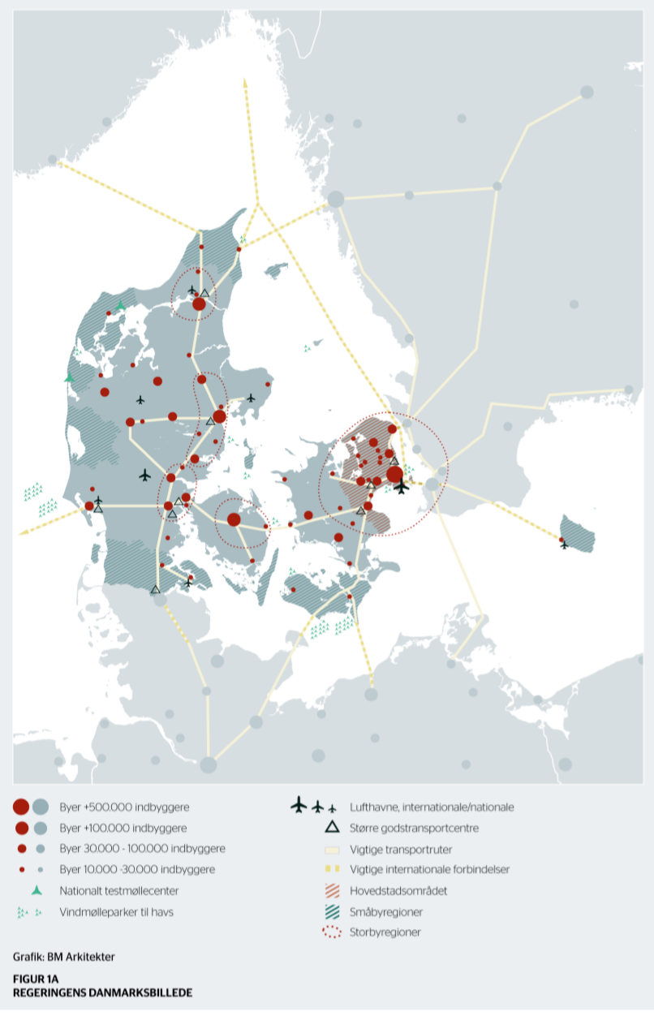
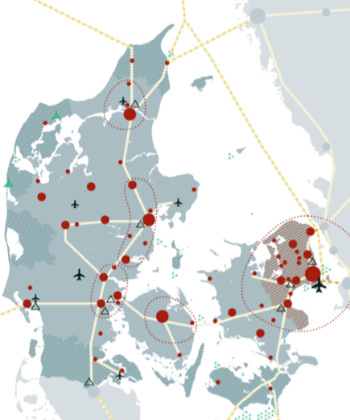
The governmental image of Denmark

Slide 22
Latvia (1)
National Development Plan 2020
Vision: Economic breakthrough – for the greater well-being of Latvia
Linked to a National Spatial Development Perspective – Latvia 2030
Priorities and strategic objectives:
Growth of the national economy
Highly productive manufacturing and internationally competitive services with export potential
Outstanding business environment
Advanced research and innovation and higher education
Energy efficiency and energy production

Slide 23
Latvia (2)
Human securitability (a form of resilience)
Decent work
Stability for demographic growth
Development of competencies
Healthy and fit for work
Belonging to Latvia: Cooperation and culture
Growth for regions
Promotion of economic activity in the regions: Unleashing the potential of territories
Availability of services for creating more equal opportunities and living conditions
Sustainable management of natural and cultural capital

Slide 24
Latvia (3)
Spatial Development Perspective of Latvia 2030
Improvement of accessibility
Planning of transport infrastructure and Public transport
Development of transport infrastructure
Development of communication network
Settlement
Growth of development centres
Urban-rural interaction
Functional network of development centres
Spaces of national interest
Rural development space
Coast of the Baltic Sea

Slide 25
Latvia (4)
Metropolitan area of Riga
Eastern border area
Outstanding areas of nature, landscape and cultural and historical territories
Implementation mechanisms
National Development Plan the main instrument
Long-term fiscal discipline
Supervision by Latvian Parliament
Inclusion in governments action strategy
Supervision by National Development Council led by vice Prime Minister
Support by independent Sustainable Development Institute

Slide 26
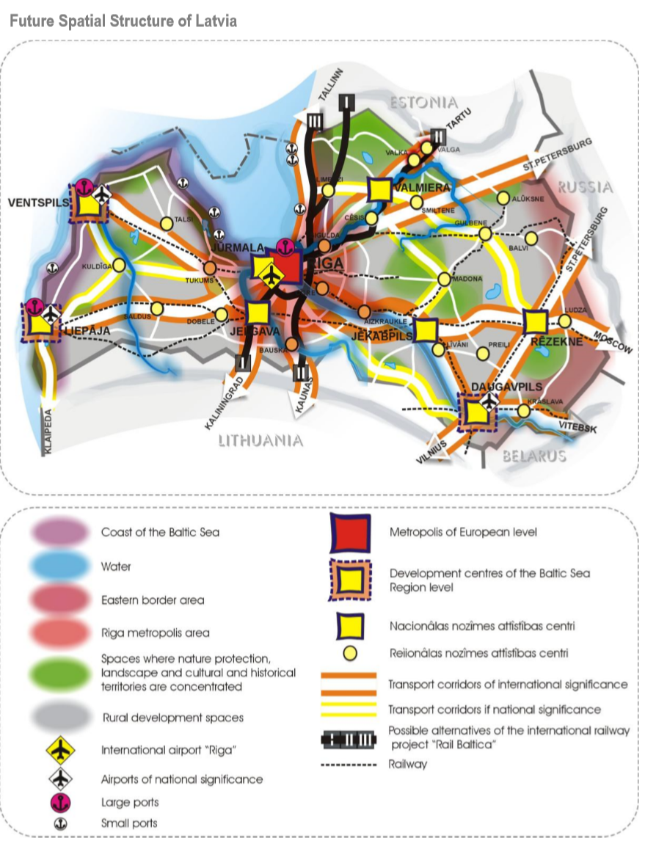
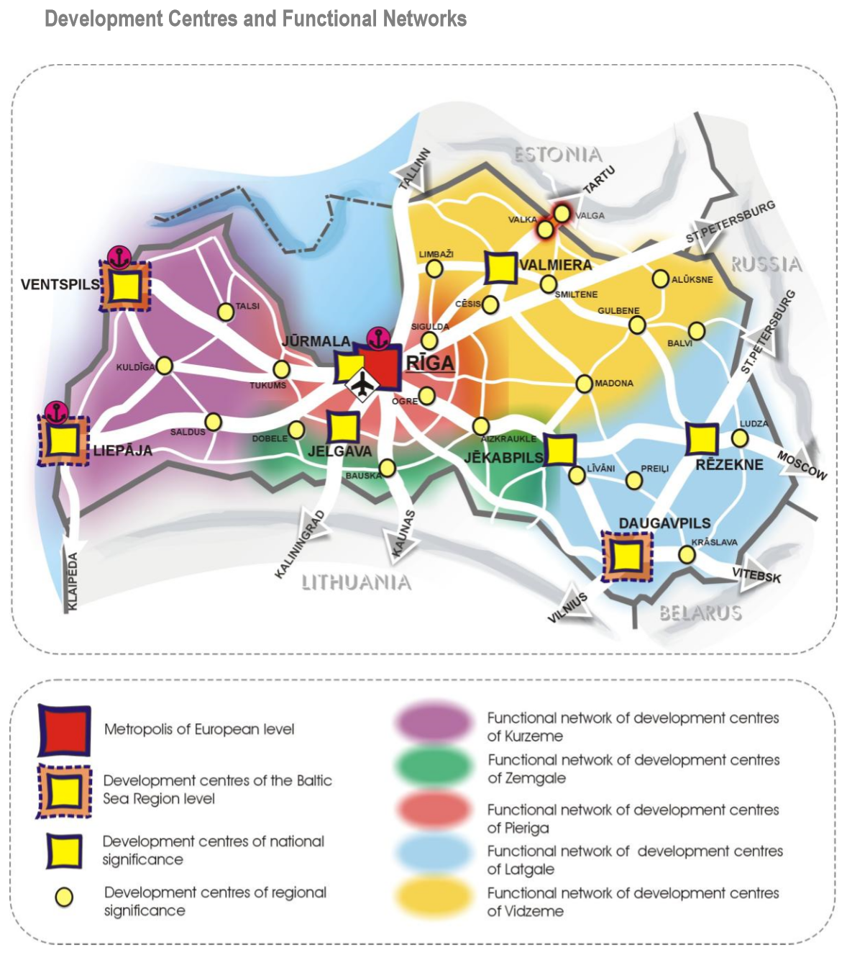
Latvia (5)

Slide 27
Reflections on the NPF (1)
Envisaged NPF themes:
Maximising the potential of our cities, towns and rural areas to be successful, sustainable places
Identifying infrastructural priorities
Transitioning to a low carbon society
Ensuring the resilience of our natural resources and cultural assets
Further development of the NPF:
Be evidence based, including the larger territorial context
Define more themes, if needed in the policy process
Respect the framework logic
Be clear on national interests and spatial structures
Give room for regional spatial and economic strategies
Ensure space for local decisions
Consider timing and a step-wise development path

Slide 28
Reflections on the NPF (2)
Promote territorial cooperation gaining critical mass/borrowing strength
Across regional and county borders
Between cities of different sizes
Support concrete tailor-made actions
Take responsibility within the NPF
Offer knowledge support to other less powerful regions, cities and counties
Involve sector policy makers and private sector to a maximum
Establish inclusive multi-level governance structures
Promote key political participation in implementation
Train and involve key human drivers

Slide 29
Reflections on the NPF (3)
Think ahead
Consider the long-term global future and seek international inspiration
Stimulate innovation and counteract diseconomies
Involve visionary “thinkers”
Stimulate attractive transformations welcoming the next generation, of citizens and the economy
Communicate, communicate and communicate…
Be visionary and clear on long term spatial structures
Visualize the territorial future opted for
Dialogue with civic society
Stimulate ownership of key public and private actors for best possible uptake

Slide 30
Thank you for your attention
pm@mehlbye.eu

