Slide 1
Census 2016: 2016 Local Area Projections
RSA Irish Branch Conference
NUIG – 9th September 2016
Mr. Paul Kilgarriff
Prof. Cathal O’Donoghue
Dr. Jason Loughrey

Slide 2
Overview
National Trends 2011-2016
Local Economy
Census 2016 – Early Indications
Live Register
Population Change
Poverty Trends
Projecting Towards 2021
Future Research

Slide 3
Economic Growth (per capita in constant prices)
After sharp decline and bouncing along bottom, we are now in recovery
15% growth – GNP per capita now higher than the peak

Slide 4
Employment Growth
Employment growth since lowest point in 2012 Q1 – 105000 jobs
However 8% less than peak → challenge to create jobs

Slide 5
Sectoral Growth 2012-Present
Fastest Growing sectors
– Agri, construction, Tourism, ICT, Professional, Industry
- Opportunities for Rural Areas

Slide 6
Regional Employment Growth 2012-Present
Employment Growth Highest on East Coast and in Commuting reach of Dublin
West - Weakest

Slide 7
Live Register NUTS 3 Regions

Slide 8
Live Register By Occupation

Slide 9
Live Register By Age & Sex

Slide 10
Local Economy

Slide 11
Demographics
Slightly younger profile both amongst children and over 65 ~Dependency Ratio above national average
Aged < 15
Net inward migration as people moved out of cities
Net Migration

Slide 12
Labour Market
National Average Employment Rate
Above Average Unemployment Rate - age profile
Employment Rate
Unemployment

Slide 13
Impact of the economic downturn on Unemployment Rate (% Change) – Type of Area
Small and Medium sized towns → biggest impact – change in unemployment

Slide 14
Industry and Structural Change
Towns < 10000 – much more reliant on Agri, Manufacturing, Construction
- Most at risk in future in terms of employment
- Challenge for rural areas → dominant sectors are those that have lost the most jobs
- Thus significant structural issues

Slide 15
Poverty and Jobless Households
Small Towns
- Double Poverty
- One third of working age households without employment – Key Cross- cutting Challenge → a hard challenge
 | Consistent poverty | Children in consistent poverty | Jobless households
Cities & suburbs | 4.9% | 8.1% | 19.8%
Towns and envi with pop=>5000 | 9.6% | 13.2% | 29%
Towns and envi with pop 1000<=<5000 | 10.1% | 14.9% | 31.5%
Mixed urban / rural areas | 7.5% | 8.1% | 24.6%
Rural | 6.5% | 8.3% | 24.3%
State | 6.9% | 9.3% | 24%

Slide 16
Census 2016 – Early Indicators

Slide 17
Change in Live Register

Slide 18
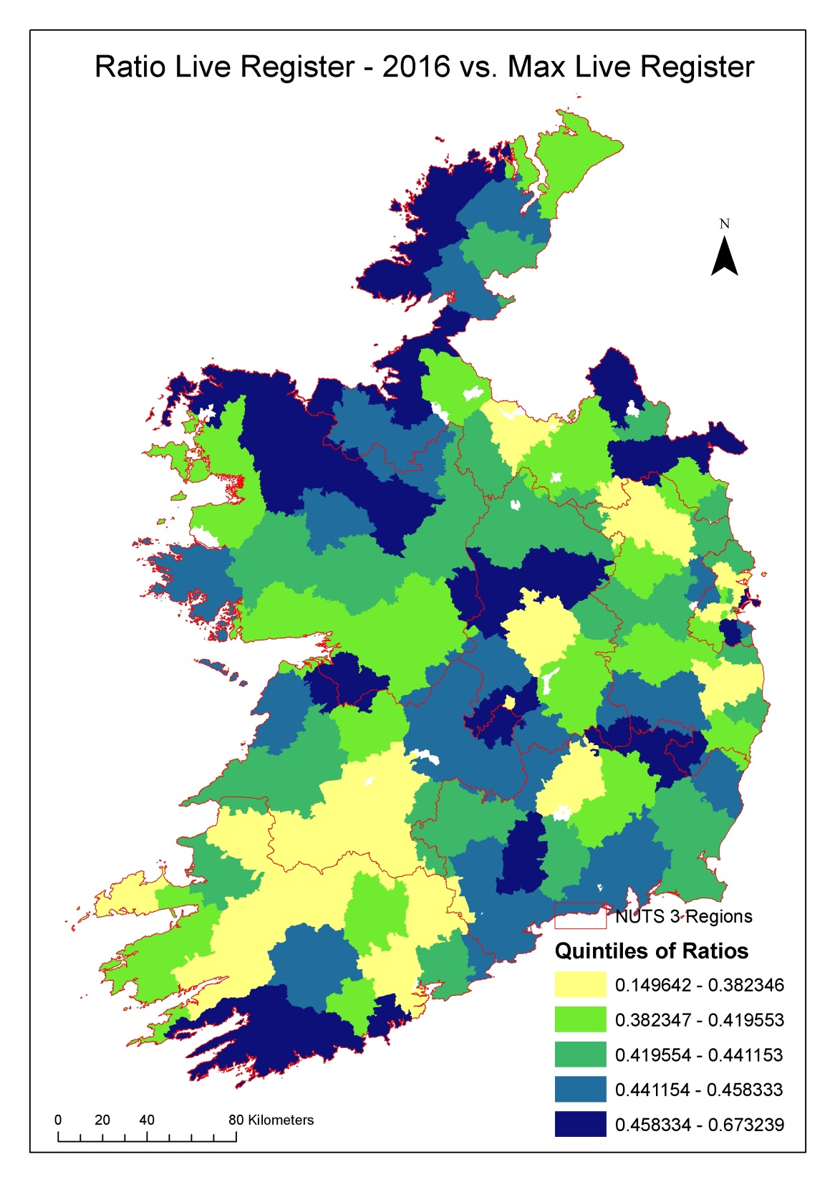
Where Are the Biggest Changes in LR?
Cities not visible in Map
Along West Coast
Wild Atlantic Way Effect?
Lowest falls in midlands

Slide 19
Characteristics by Strength National Average = 100
Lowest Population Growth towns have higher unemployment, older, worse educated, furthest from to hub, commuting out
 | Ave Change in LR | Old:Young | Tert Ed Share | Distance to Closest Hub | Net Migration | Share of Net Jobs
Largest Fall | 76 | 89 | 112 | 47 | -0.05 | 0.09
2 | 95 | 99 | 92 | 115 | -0.04 | -0.02
3 | 103 | 102 | 98 | 103 | -0.05 | -0.05
4 | 109 | 104 | 98 | 126 | -0.05 | -0.01
Lowest Fall | 119 | 106 | 100 | 108 | -0.06 | -0.06

Slide 20
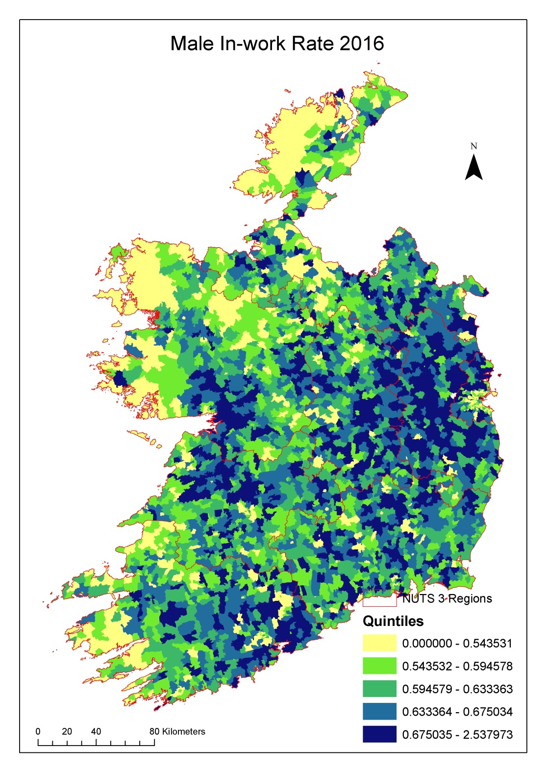

Slide 21
Population Changes

Slide 22
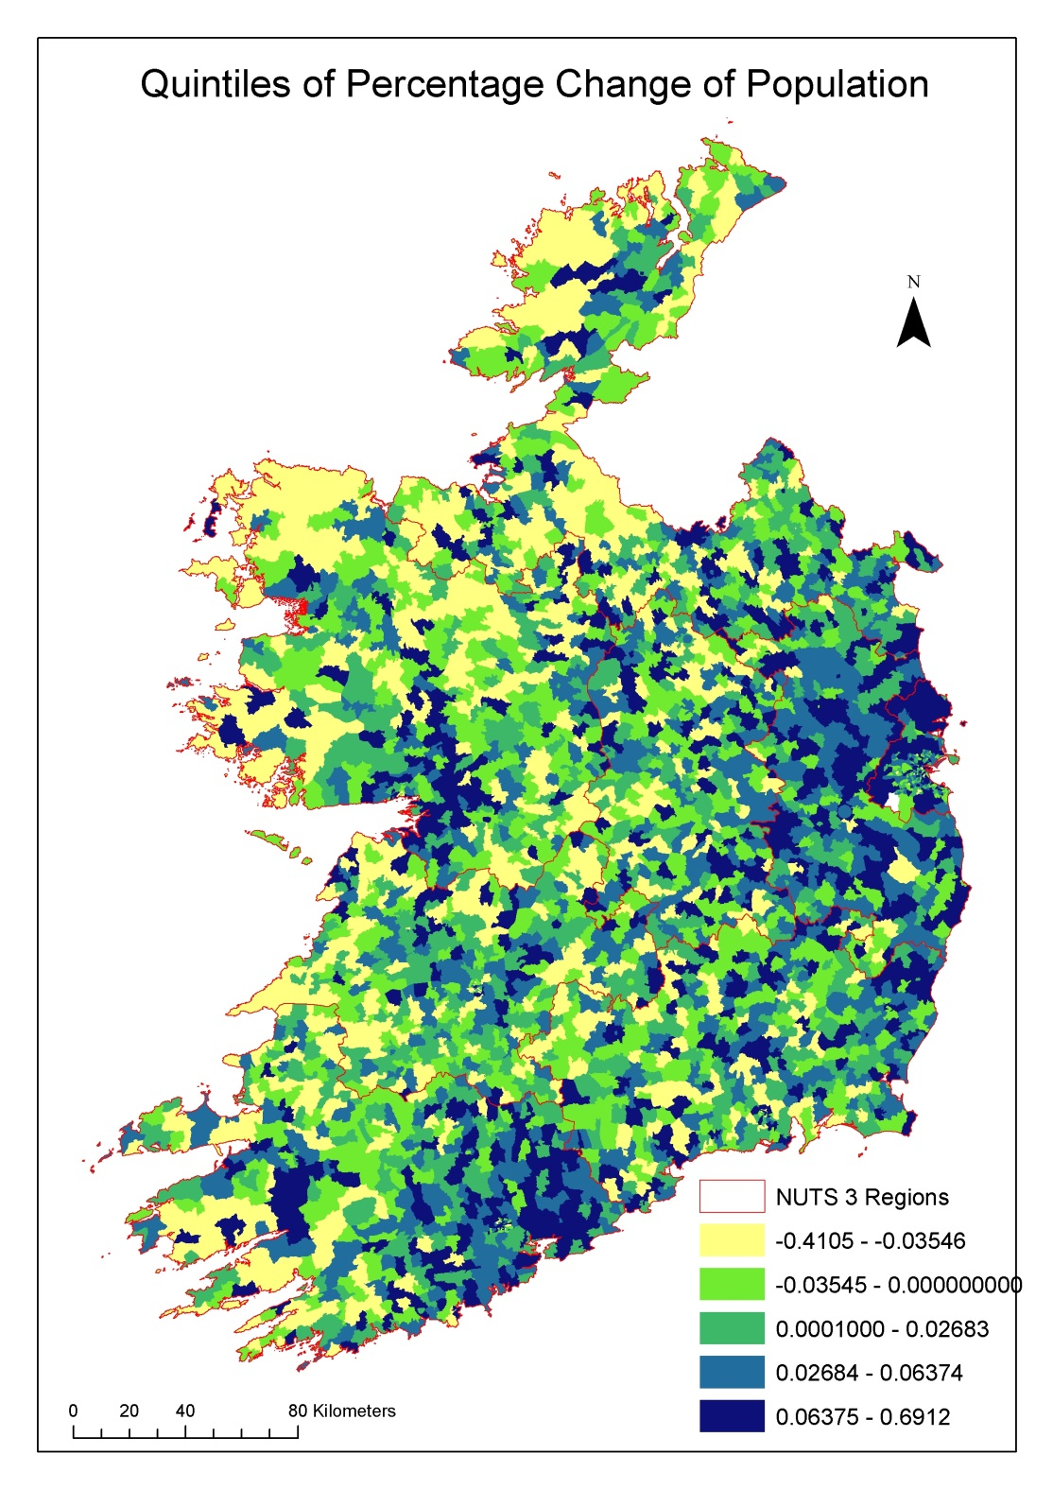

Slide 23
Characteristics by Strength National Average = 100
Lowest Population Growth towns have higher unemployment, older, worse educated, furthest from to hub, commuting out
 | Ave % Pop Change | Old: Young | Tert Ed Share | Distance to Closest Hub | Net Migration | Share of Net Jobs
Lowest | -120 | 107 | 87 | 111 | 0.23 | -420
2 | 14 | 105 | 94 | 110 | 0.05 | -130
3 | 79 | 101 | 101 | 94 | 0.03 | 171
4 | 158 | 98 | 104 | 100 | -0.02 | 142
Highest | 345 | 91 | 114 | 86 | -0.04 | 577

Slide 24
ED’s Classified – Urban / Rural
 | 2011 | 2016 | Actual | % Diff
Dublin County | 568,051 | 609,323 | 41,272 | 7.3%
Dublin City | 705,242 | 736,131 | 30,889 | 4.4%
Cork | 193,526 | 203,235 | 9,709 | 5.0%
Limerick | 63,598 | 65,065 | 1,467 | 2.3%
Galway | 79,159 | 83,243 | 4,084 | 5.2%
Waterford | 51,536 | 53,600 | 2,064 | 4.0%
Town 10,000+ | 815,956 | 853,916 | 37,960 | 4.7%
5,000 - 9,999 | 301,601 | 313,967 | 12,366 | 4.1%
3,000 - 4,999 | 151,087 | 157,984 | 6,897 | 4.6%
1,500 - 2,999 | 262,423 | 269,953 | 7,530 | 2.9%
Village | 673,979 | 685,832 | 11,853 | 1.8%
Rural | 721,083 | 724,607 | 3,524 | 0.5%

Slide 25
Poverty Trends

Slide 26
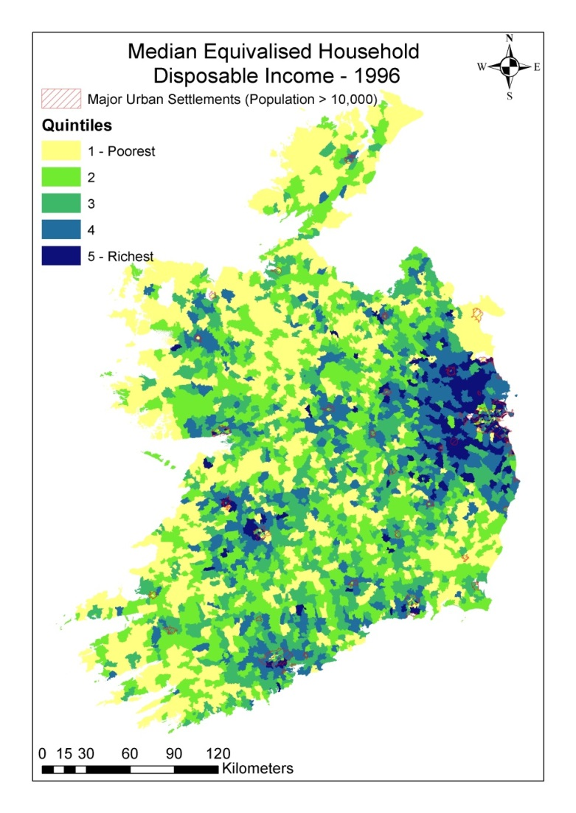

Slide 27
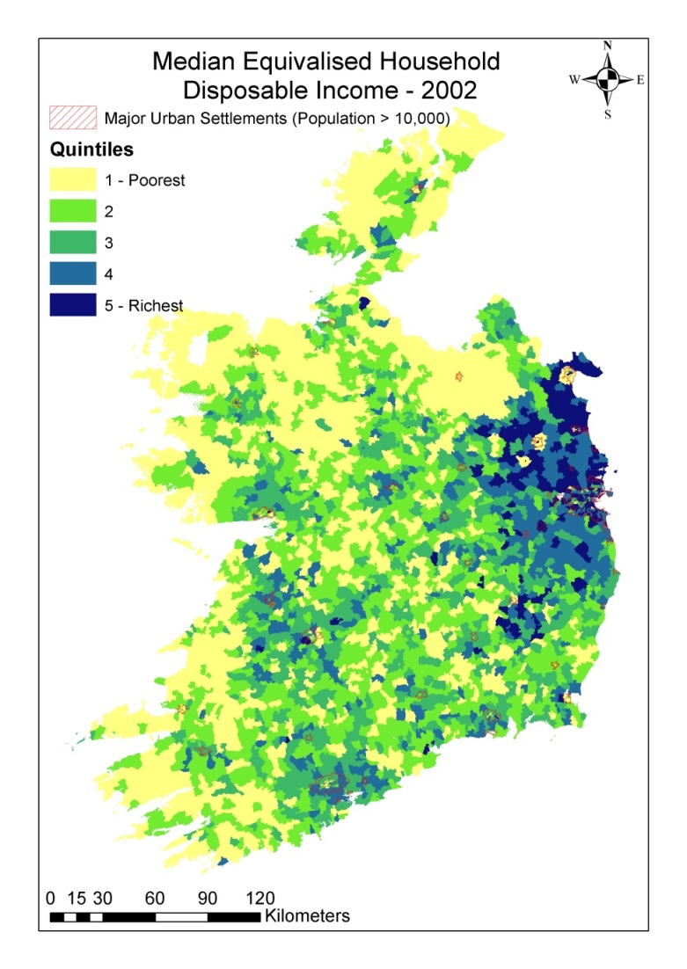

Slide 28
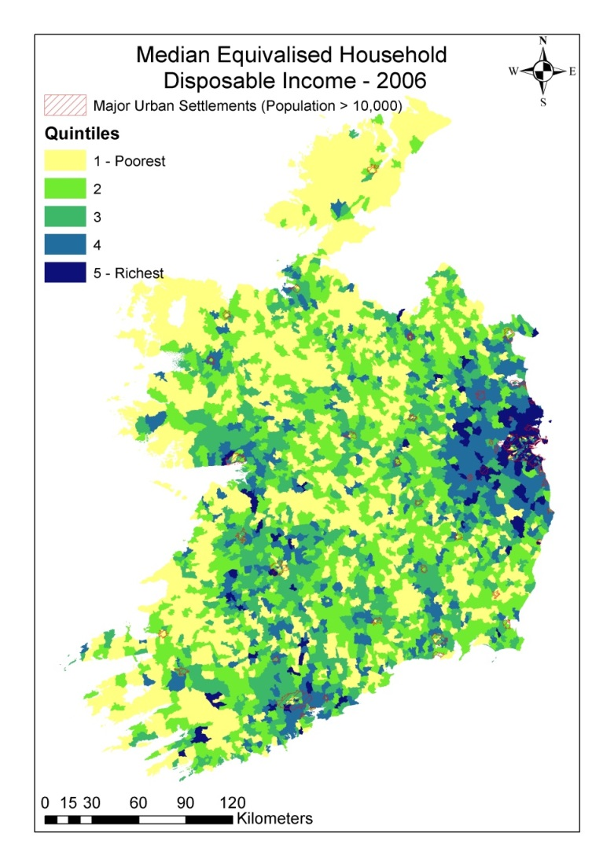

Slide 29
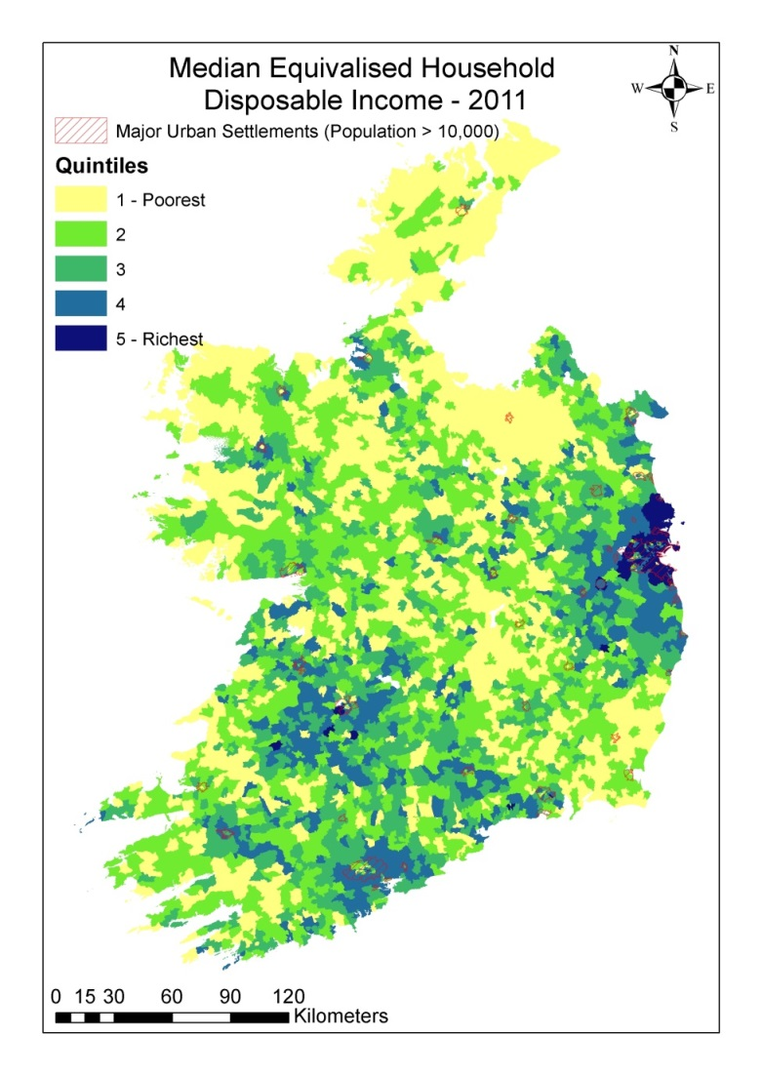

Slide 30
Challenges

Slide 31
National Spatial Strategy
Recognise
Quite a young population in towns, even in more remote areas
Skills level often lower, particularly in weakest towns
Higher unemployment, Jobless Households
Negative Equity
Likely to remain so for the foreseeable future
The issue will not go away
Long term challenge for services and economic development
Existing NSS weak on towns →vital to have a national policy for these area
Nationally as many people live in rural towns as in Greater Dublin!!

Slide 32
Local Economic and Community Plan
Development requires a different mind-set
Taking risks
Proactive not passive
Focus on finding solutions
Need to identify strengths and optimising them
Build community capacity
Top-Down will not work in the long term
Rural Economic Development Zones – emphasise bottom up
Communities don’t necessarily have the skill set
Capacity Building Necessary
Spread the load
Partner with other agencies (both national and local)
→ Local Community and Development Committees critical in coordination at local level
Jobless households is a multi-dimensional problem

Slide 33
Projecting Towards 2021

Slide 34
Spatial Datasets
All at the Electoral District Level
Income Data – Individual & household level (SMILE)
Characteristics – Age, education, occupation, industry (SMILE)
Housing Data – Rent & Prices (Imputed Data)
Commuting Costs – POWSCAR & OD Cost Matrix
Journey times, journey costs, road network
Spatial Data – Amenities, facilities, climate, happiness
Environmental Data – Water Status, elevation, topography
Agricultural Data – NFS

Slide 35
Next Steps
Create SMILE model simulated income measure for Census 2016
Small Area analysis of income, poverty and demographics
Project SMILE model income measure into the future under a number of potential scenarios
Increased/Decreased/Constant Population Growth
Level of Growth in the Economy
Data required on underlying economy to project forward to 2021
The more information and data the more accurate the projections!!!!

