Slide 1
Place leadership and governance
Markku Sotarauta

Slide 2
Content
  A growing recognition of the
  need to reinsert questions of
  agency in accounts of regional performance
What is leadership all about?
Why place leadership?
Identifying place leadership
The space place leaders have
Conclusions

Slide 3
Place leadership
Growing (but still limited) literature, and emerging consensus, on the nature, origins and expression of place leadership
A series of studies concluding the problem is poor leadership
Place leadership still is the missing factor in the regional development puzzle (Rodriguez-Pose 2013)
Andrew Beer: Is Place Leadership the Higgs Boson of the Social Sciences?

Slide 4
What is leadership all about?

Slide 5

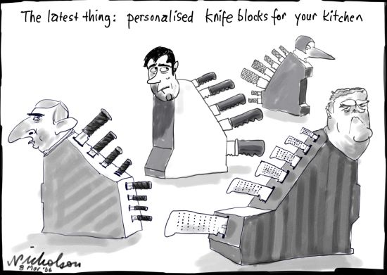


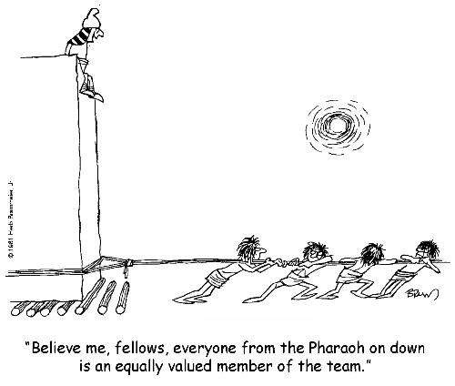

Markku Sotarauta

Slide 6
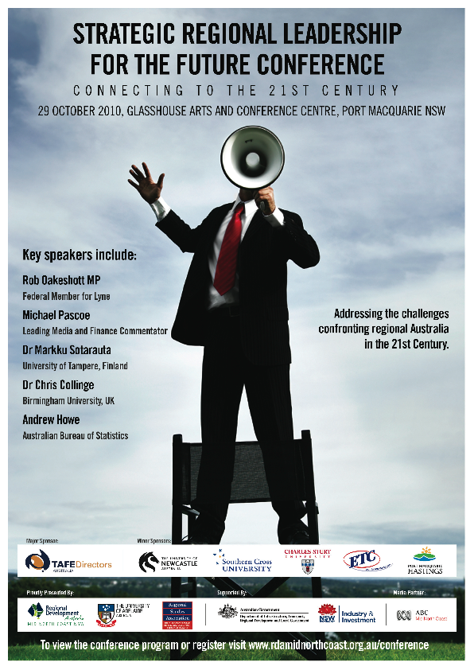
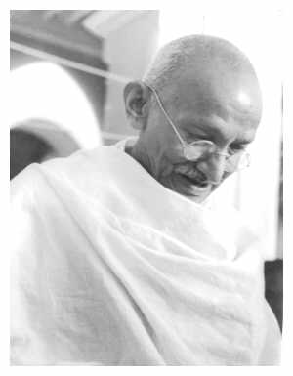
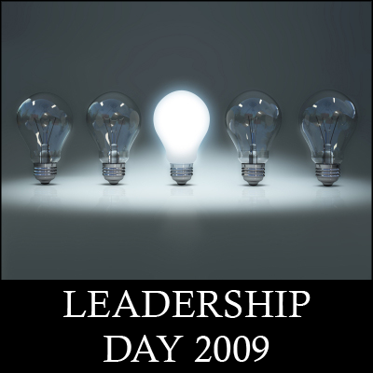




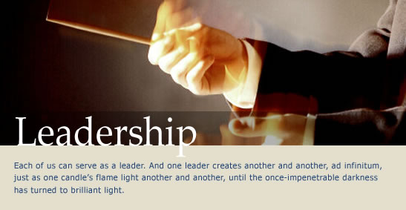
Markku Sotarauta

Slide 7
To put it simply I
Leadership is about creating a way for people to contribute to making something different happen
Notes:
Leadership is a complex social phenomenon,
lacking clear boundaries and a clear definition is elusive

Slide 8
To put it simply II
To go before or to show the way
To influence or to induce
To go head of or in advance of
To have the advantage over
To act as leader
To go through or pass
To act as guide
  (Webster’s dictionary)

Slide 9
Why place leadership?

Slide 10
My dear child
Place leadership
Place-based leadership
City leadership
Rural leadership
Cluster leadership
Regional leadership
Territorial leadership
…
Leadership in-between
Distributed leadership
Shared leadership
Hidden leadership
Emergent leadership
…

Slide 11
Why place leadership
Mismatch between policy recommendations and
knowledge on how to do it all
The perils of reactionary policies
Neglected power and politics
New modes of governance
Every-day complexity
Hollow rhetoric of poor leadership or lack of leadership

Slide 12
Why place leadership
Mismatch between policy recommendations and
knowledge on how to do it all
The perils of reactionary policies
Neglected power and politics
New modes of governance
Every-day complexity
Hollow rhetoric of poor leadership or lack of leadership
  Better evidence-based guidance on what
  to do but also on how to go about doing it

Slide 14
Identifying place leadership

Slide 15
Place is a unique setting to study leadership
Many complex ‘wicked issues’
Ever-changing: Subject to unanticipated & episodic ‘crises’
Highly differentiated (history, geography, culture, language…)
Multiple identities
Highly emotionally charged –‘irrational’
Places are not isolated – but are connected to, and influenced by, ‘wider worlds’…
The differing ‘knowledgeability’ within and between place(s)
  (applying Patsy Healey and John Gibney)
Notes:
We need a better alignment than currently exists -between leadership, place and policy discourses
So that leadership in the urban and regional studies context can be theorised, explained and improved upon in the field – PLACE, Leadership, POLICY

Slide 16
Place leaders
stretch constraints while managers operate within them
  reach beyond their familiar fields of activity and policy spheres to influence
  reach beyond those individual organisations and institutions that authorise them to take the lead in the first place
  are required to influence actors who are not by definition their followers, and conversely

Slide 17
Place leadership
No one is ‘in charge’ – no command and control; beyond deference and formal authority
Leadership may be everywhere
  Followers are not assigned to leaders
    Followers always have a choice not to act and follow – the position needs to be earned

Slide 18
Some observations from empirical studies
Regional development practices are to large extent indirect in nature (but not only)
Systemic not personal quality (Parkinson et al 2012; Norman 2013)
Continuous struggle for influence within and between regions
Leaders build bridges between informal and formal initiatives (Horlings 2010)
Leadership is embedded in a social fabric of a place (Peters 2012)
  Specifically in the social relationships of an influence network (Sotarauta 2014; MacNeill and Steiner 2010).

Slide 19
Some observations from empirical studies
Interpretive power, network power, institutional power (Sotarauta 2009)
  Leaders aim to influence the ways collective interpretations emerge and are shaped (Horlings 2010; Sotarauta 2009)
  Leaders stimulate stakeholder engagement (Gomes & Liddle 2010; Beer & Baker, 2012)
  Leaders are knowledge brokers (Gibney 2011)
Leadership is a relay directing emergence (Sotarauta & Mustikkamäki 2012; Sotarauta 2016)

Slide 21
Place leaders (skillful ones)
  aim at creating novel context for collective action instead of directly directing the course of actions and events
  induce, or rather ‘seduce’, other actors to do something differently (mobilisation)
  do not aim to challenge preferences of the other actors
    but aim to combine individual aims to collective regional objectives
  aim to multiply the opportunities and alternatives for other actors

Slide 22
The space place leaders have

Slide 23
Leadership studies in the regional development context
(Sotarauta & Pulkkinen 2010)
Three perspectives in mind
  the process perspective that informs a study on dynamism of regional development and secures a temporally conscious approach
  network perspective that informs about the social relationships of the actors in and beyond the regional development world
  governance perspective that informs about the wider systemic issues framing and molding both the actual systems and forms of leadership

Slide 24
Governance systems
  dictate resources and formal position of the local development work, and thus also to leaders
The financial capacity
  affects the local capacity to manoeuvre and the space local leaders have for their action

Slide 25

Finland | South Australia
Finnish respondents to the survey tended to be older, better educated and more experienced than their Australian counterparts
25 % of Finnish respondents held a PhD and fully 75 % held a post-graduate qualification, 3 times the rate for Australia.
Specialist degrees in the social sciences, technology or business | Business degrees dominant
60 % had been associated with regional development for 15 years or more | 16 % had been associated with regional development for 15 years or more
(Sotarauta & Beer 2016)

Slide 26
Finland | South Australia
PL grounded in well-developed public sector institutions with specialist staff with specialist training | PL dependent on the voluntary efforts of individuals from the private sector and the broader community.
PL embedded in a complex governance setting | PL indirect - the centralizing tendency of central governments vs. independently-minded local leaders
Fairly open | Less open (reflected in a reluctance to debate regional needs publicly, as well as a lower level of engagement with residents, the community and voluntary sectors)
(Sotarauta & Beer 2016)

Slide 27
Finland | Australia
PL institutionally based Authority derived from inside government | PL individualised Authority derived from outside of government
A co-ordinated market economy | A liberal market economy
Place leadership, as it finds institutional expression in Finland, is one manifestation of strategic interaction amongst firms, public agencies and other actors. Is this type of interaction more common in co-ordinated market economies than in liberal market economies?
(Sotarauta & Beer 2016)

Slide 28
Three types of place leaders
(Sotarauta 2016)
Bureaucratic leaders
  lead their own organisations
  do what they are supposed to do
Assigned leaders reaching beyond
  lead their own organisations but also aim to influence actors beyond their formal assignment
  aim to exercise influence by, with and through other actors.
Non-assigned leaders
  willingness and capabilities to take leadership position
  do what they are not supposed do but what they feel needs to be done.

Slide 29
Conclusions

Slide 30
What do we know?
  Place leadership
    Appears to be important
    Can deliver positive outcomes (but also negative)
    Has characteristics we can describe (Higgs-Boson thing)
    Most usually understood through case studies
    BUT
      Too great a focus on ‘good news’ and case studies
      The challenge of ‘contingencies’ - comparative studies called for
      Key relationship between governance and leadership

Slide 31
Effective development
efforts call for leadership
What is the right place for individuals
in economic transformation of regions/locations?
”Do individuals make history, or does history
make individuals who make history?”
(Richard Samuels)

Slide 32
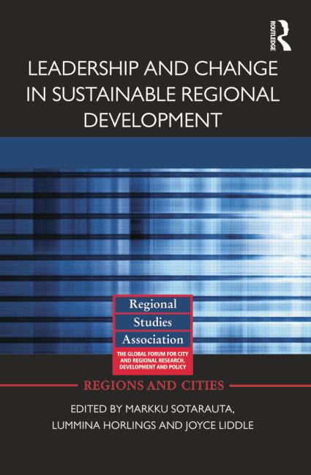
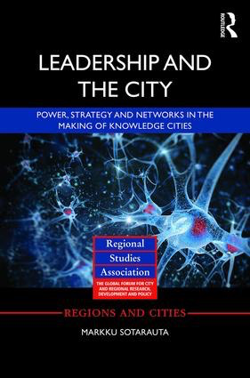
Who influences whom, how,
for what purpose and
in what kind of context
– and with what outcomes?

