Slide 1
The Effect Agglomeration Economies on Firm Deaths: A Comparison of Regional and Firm Based Approaches
By
Justin Doran (University College Cork)
Bernadette Power (University College Cork)
Geraldine Ryan (University College Cork)

Slide 2
Objective
The paper analyses the effect of agglomeration economies on firm deaths over the 2007/08 economic crisis in Ireland.
It compares regional and firm based approaches in analysing the effect of agglomeration economies on firm deaths.

Slide 3
Motivation
Little is known though about the extent to which spatial agglomeration affects firm exits.
Two Key Recent Studies
Regional level:
Cainelli et al. (2014) at the industry province level of Italy shows that specialization negatively impacts firm exit rates in the short run, particularly those of low-tech firms.
Firm level:
Basile et al. (2016) find asymmetric sectorial effects of agglomeration economies on start-up firm’s survival of Italian firms between 2004 and 2010.

Slide 4
Motivation
But Basile et al. (2016) argues that a firm level approach is superior to regional approaches as it enables firm characteristics to be accounted for.
Multilevel estimation shows that between firm variance explains a large share of the variance in new firm survival (van Oort et al. 2012; Ferragina, & Mazzotta, 2015).
Should we rely on multilevel analysis?
What about spatial dependence?
Do regional approaches provide additional insights?

Slide 5
Motivation
This paper investigates whether there is merit in looking at spatial agglomeration at both firm and regional levels.
No empirical analysis to our knowledge directly compares the two approaches using the same dataset.

Slide 6
Data
Irish business demography data (2007-2010) collated from administrative sources by the Central Statistics Office (C.S.O.) in Ireland.
Each enterprise is classified by NACE Revision 2 Sectors A-U, it survival status, along with its associated employment.
The location of a large proportion of enterprises (60%) are geocoded to District Electoral Division (DED).
There are over 3,000 DEDs in Ireland of average geographical size (23km).

Slide 7
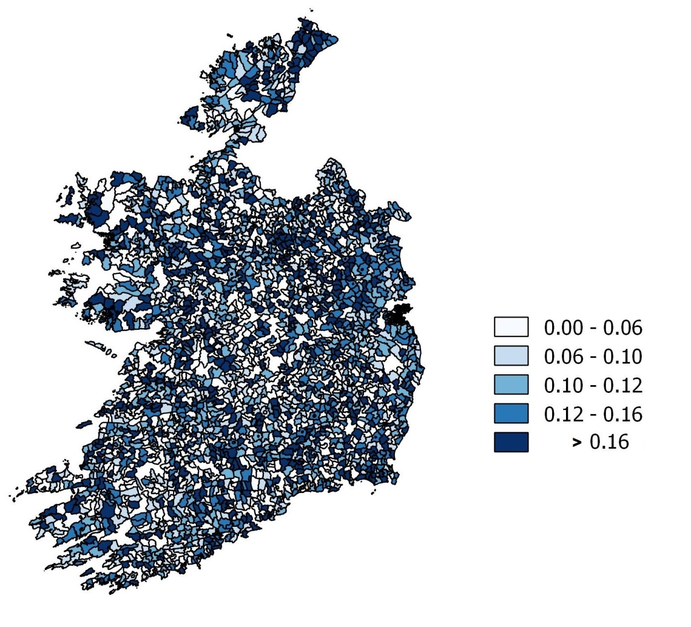
Dependent Variable: Exits
Figure 1: Enterprise Deaths Rates (DED)
Enterprise Deaths
Firm analysis
Exit = ‘1’ if the firm died between 2007 and 2009 inclusive and ‘0’ otherwise
Regional analysis
Average annual death rate between 2007 to 2009.

Slide 8
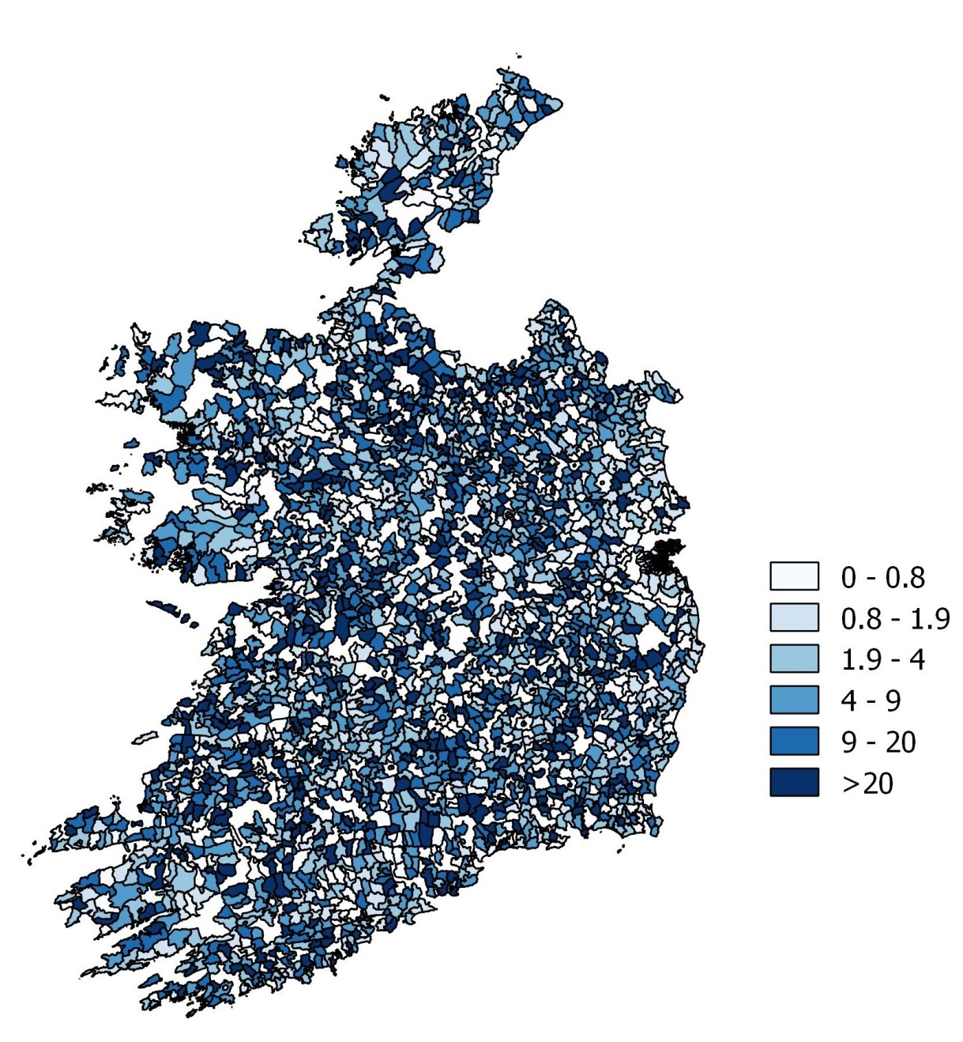
Measures of Agglomeration
Localization Economies
Location quotient (LQ)
$${LQ}_{s,j}=\frac{{E_{s,j}}/{E_{j}}}{{E_{s,n}}/{E_{n}}}$$
where E_{s,j} is the employment in sector s (two-digit NACE classification code) in DED j and E_{s,n} is the employment in sector s nationally (n).
Compares the concentration of a sector in a DED to the concentration of the same sector nationally.
Concentration is approximated using share of sector employment.

Slide 9
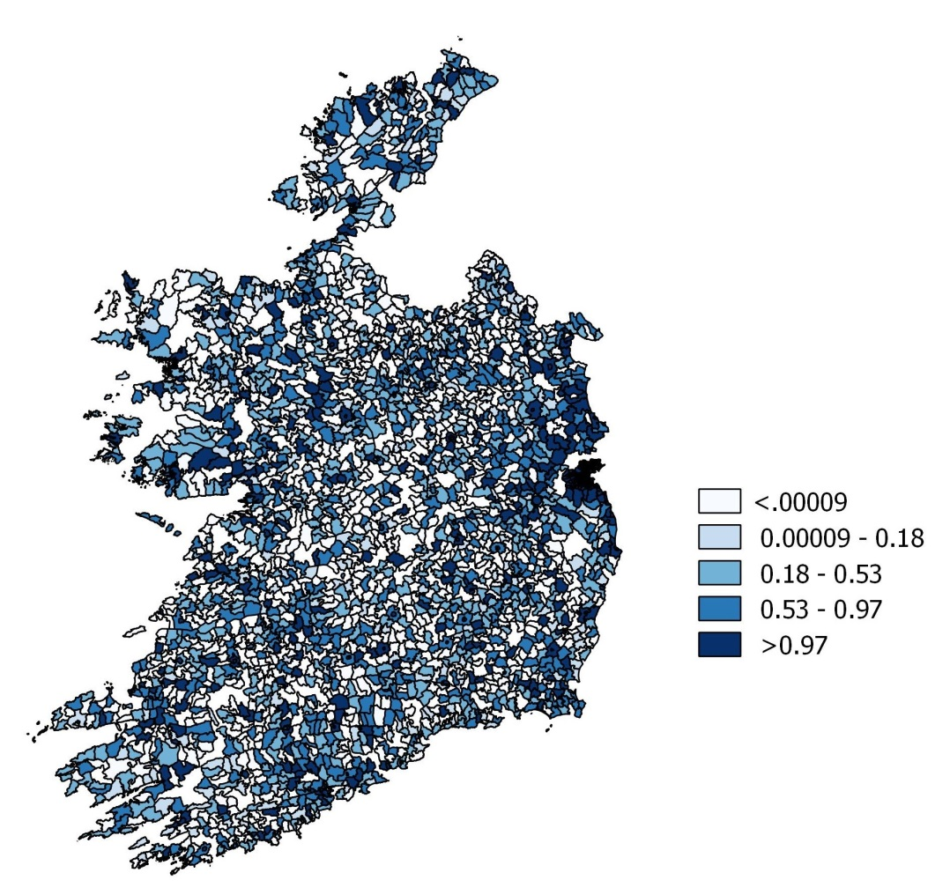
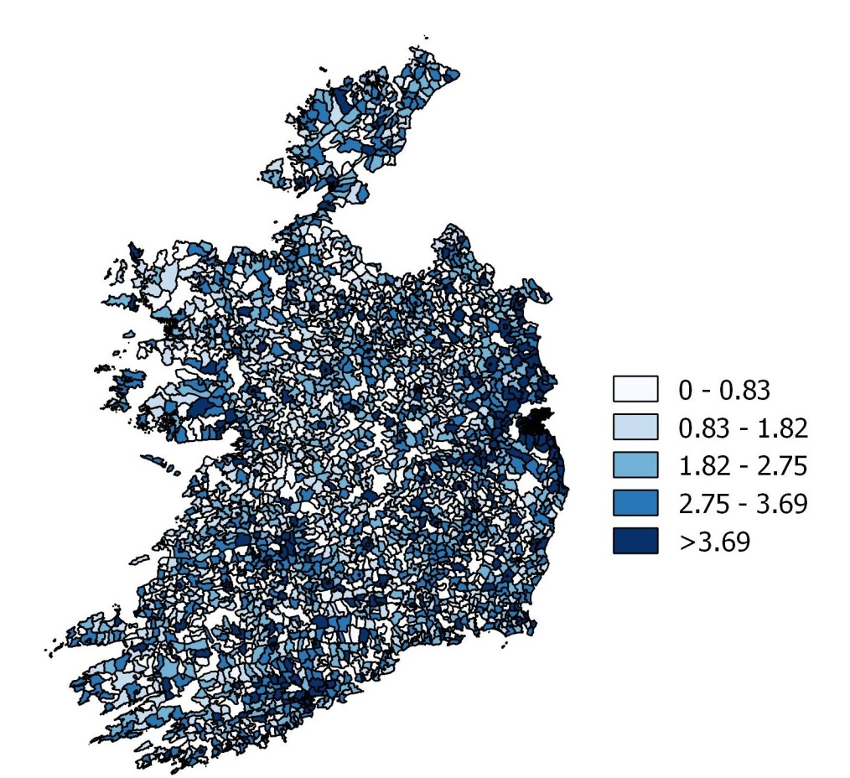
Measures of Agglomeration
Diversification
Related variety is captured by the weighted sum of entropy at the four digit NACE classification system within each two digit NACE classification system. Related and unrelated variety are calculated following Frenken et al. (2007).
Related variety
Unrelated variety

Slide 10
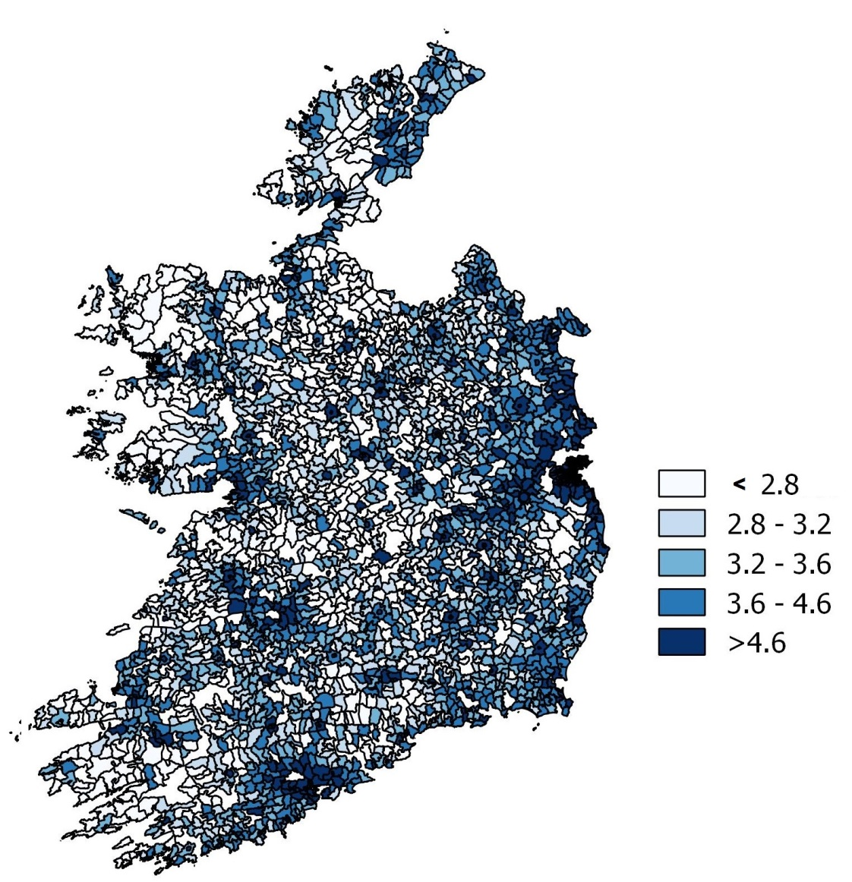
Measures of Agglomeration
Urbanisation
Population density in each DED
${UE}_{j}=\frac{{POP}_{j}}{{Area}_{j}}$
where Area_{j} is the area of the DED (Km²).

Slide 11
Methods
Regional
A cross-sectional spatial autoregressive model of form:
dj – average yearly death rate in DED j
Endogenous spatial lag -$ρ_{1}Wd_{j}$
Spatial autoregressive error term$− ε_{j}$
Firm
Complementary log-log model where we
Correct the standard errors for intraregional correlation in the errors by clustering based on DED j in the variance covariance matrix.
Include the distance decay effect to control for the effect of agglomeration externalities in neighbouring regions

Slide 12
Distance Decay
Distance Decay
Weighted average values of each agglomeration variable X_{j} are computed using spatial weights Wjr based on the inverse arc distance from the centroid of the region j and neighbouring region r as follows:
$DDE of X_{j}= \sum_{r=1}^{R}{W_{j,r}}X_{j}$

Slide 13
Variables | Cross-sectional spatial autoregressive model | Contemporary Log log
Zero employees (proportions /dummy) | 0.126***(0.0223) | 2.016***(0.0930)
1-4 employees (proportions /dummy) | 0.0733***(0.0191) | 1.783***(0.0538)
5-9 employees (proportions /dummy) | 0.0209(0.0227) | 0.589***(0.0472)
10-49 employees (reference)
50+ employees (proportions /dummy) | -0.0494(0.0817) | -0.883***(0.1330)
Related_variety | 0.0438***(0.0104) | 0.0369(0.0823)
Unrelated_variety | 0.0288***(0.0044) | 0.039(0.0488)
Location _quotient | -6.00e-05**(2.49e-05) | -0.0019***(0.0006)
Population_density | 0.0057(0.0054) | 0.0995**(0.0422)
Ln_(Related variety*W) |  | 1.098***(0.2470)
Ln_(Unrelated variety*W) |  | -0.577(0.4870)
Ln_(Location quotient*W) |  | 0.0689(0.0559)
Ln_(Population_density*W) |  | -0.777**(0.3740)
Constant | 0.00819**(0.00341) | -4.582***(0.75)
lambda | 0.138**(0.0578)
rho | -0.168**(-0.0688)
Observations | 2,599 | 176,518
Positive coefficients ($β^{′})$ indicate that larger values of X_{i} increase death (hazard) rates.
Negative coefficients ($β^{′})$ indicate that larger values of X_{i} reduce death (hazard) rates.

Slide 14
Key Findings
Regional
Positive spatial dependence.
Localization economies lower regional deaths rates.
Diversity raises regional deaths rates.
Regions with a higher proportion of smaller firms had relatively higher regional firm deaths rates.
Firm
Localisation economies lower the hazard rate of the firm.
Urbanization economies raise the hazard rate of the firm.
Firms bordering regions with greater population density face a lower hazard rate.
Firms bordering regions with greater related diversity face a higher hazard rate.

Slide 15
Conclusions
Differences in the results at firm and regional levels - indicate the importance of taking a comprehensive approach to examine the influence of agglomeration on firm exits.
Different information for policy makers - spatial autoregressive models inform about the existence and nature of spatial dependence at a regional level. Hazard models capture likely sources of this dependence in the distance decay effects.

Slide 16
Conclusions
Multilevel and hierarchical solutions proposed by van Oort et al. (2012) need further development to account for spatial dependence and thereby the effect of neighbouring regions.
Corrado and Fingleton (2011) outline potential approaches but greater empirical research is required.

Slide 17
Thank You
Contact Details:
Justin Doran:
justin.doran@ucc.ie
Bernadette Power:
b.power@ucc.ie
Geraldine Ryan:
g.ryan@ucc.ie
?

