Slide 1


2016 Regional Studies Association Conference
NUIG Aras na Macleinn, 9th September 2016
A reinvigorated Smarter Travel Policy needs to be at the centre of the National Planning Framework
David O’Connor, DIT
david.oconnor@dit.ie
Notes:
1

Slide 2
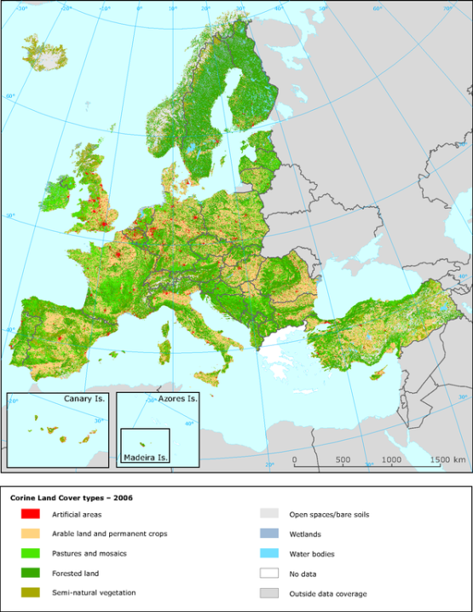
European Environment Agency study:
Ireland the “Worst Case Scenario” of Urban Planning in Europe
“…as a result of extremely passive planning policies”
Source: www.eea.europa.eu, 2006

Slide 3
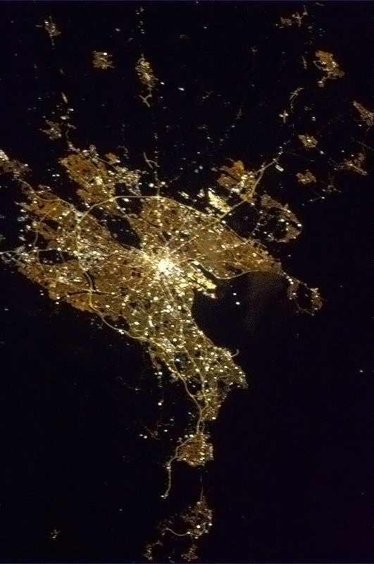
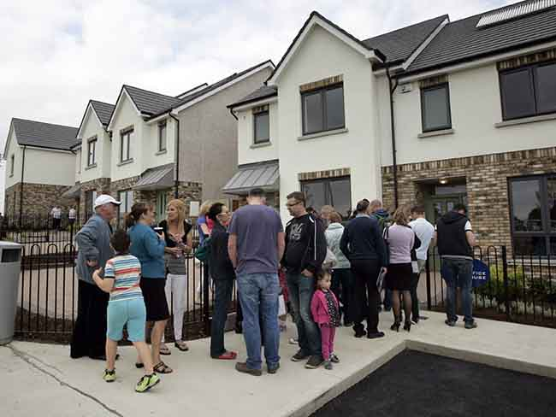
“The Green Fields of Ireland”
THE LEGACY OF DUBLIN’S HOUSING BOOM AND THE IMPACT ON COMMUTING, Caulfield & Aherne, ITRN, 2014
People living in housing built after 2001 are more likely to drive and travel further than those living in older housing
“A city region in transition”
1 in 3 houses nationally built between 1992 and 2008

Slide 4
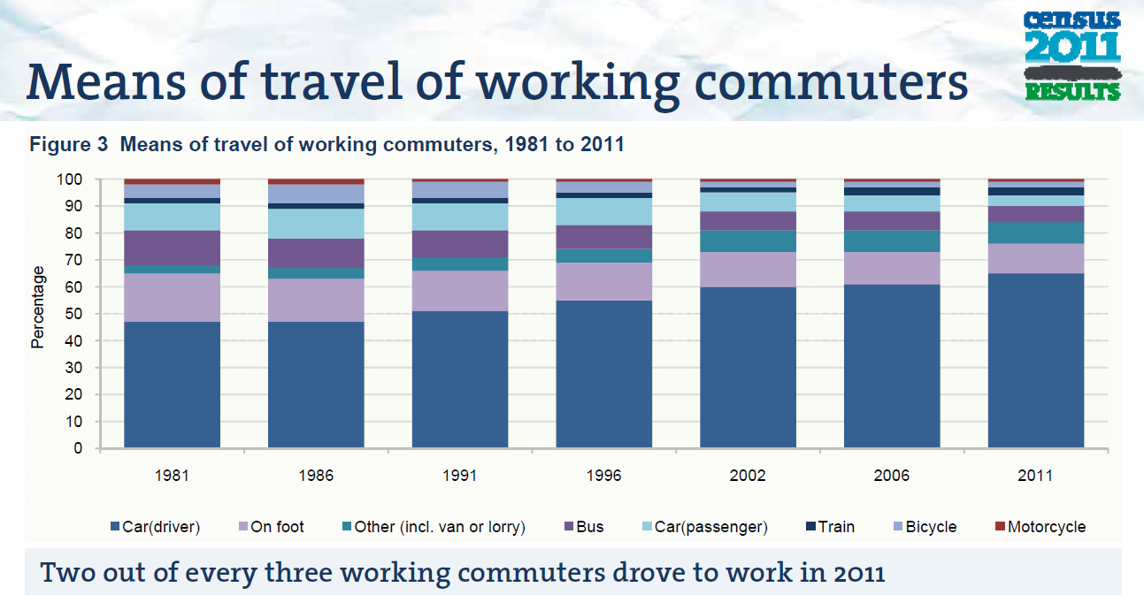
increasing carbonisation / decreasing health
Source: CSO, 2011
... Peak focus.

Slide 5
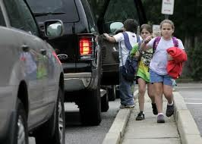
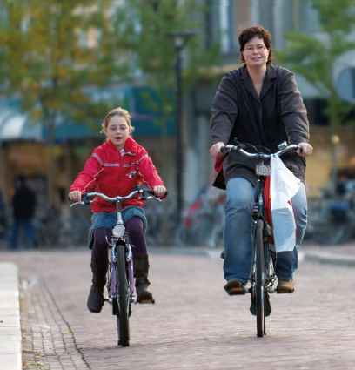
…Children’s Mobility is worsening…
Irish 12yr olds who walked or cycled to school*
  1981: 51%
  1991: 44%
  2002: 27%
  2006: 25%
  2011: 24%
  * Health Impacts of Transport, Institute of Public Health in Ireland / CSO Census 2011

Slide 6
…a growing Gender Gap in active travel…
Total number of male & female cyclists in State from 1986 to 2006
Overall numbers have dropped from 147,000 to 54,000.
Female share has dropped from 37% to 21%.
The cycling gender gap is approximately 4:1 in Dublin.
Source: Mark Geddes, DIT dissertation 2009

Slide 7
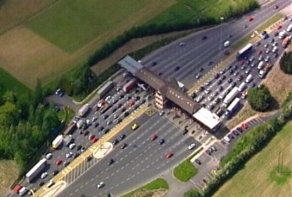
DTTAS: “Investing in our Transport Future” Report, 2014
“Investing in Our Transport Future”, the Strategic Framework for Investment in Land Transport was published in December 2014 by the Department of Transport, Tourism and Sport. Its overt intent was to justify renewed investment in transport infrastructure. But it also included critical review points: -
Both the car fleet and commercial vehicle fleets have roughly doubled in size compared to their levels in the early 1990s.
The net result is that, for example, there were 1.06 million
people driving to work in 2011 compared to 440,000 in 1991
– an increase of 140%.
The census shows that combined mode share for walking,
cycling and public transport stood at 34% in 1991 and had fallen to 24% by 2011.
To put these changes in context, 625,000 more people drove to work in 2011 than in 1991, but there were only 4,300 additional bus commuters.

Slide 8
DTTAS: “Investing in our Transport Future” Report, 2014
“Investing in Our Transport Future”, the Strategic Framework for Investment in Land Transport was published in December 2014 by the Department of Transport, Tourism and Sport. Its overt intent was to justify renewed investment in transport infrastructure. But it also included critical review points : -
“Transport policy has consistently had a stated aim of achieving modal shift away from the car.
This aim has been based on reducing and avoiding the direct costs of congestion, recognising the cost of increasing road capacity to meet ever growing demand, and also recognising that for urban centres, increased road capacity is not an option.
In terms of future transport investment, and indeed policy implementation, it must be recognised that such aims have not been achieved;
even the most recent trends suggest further growth in car mode share for commuting.”

Slide 9
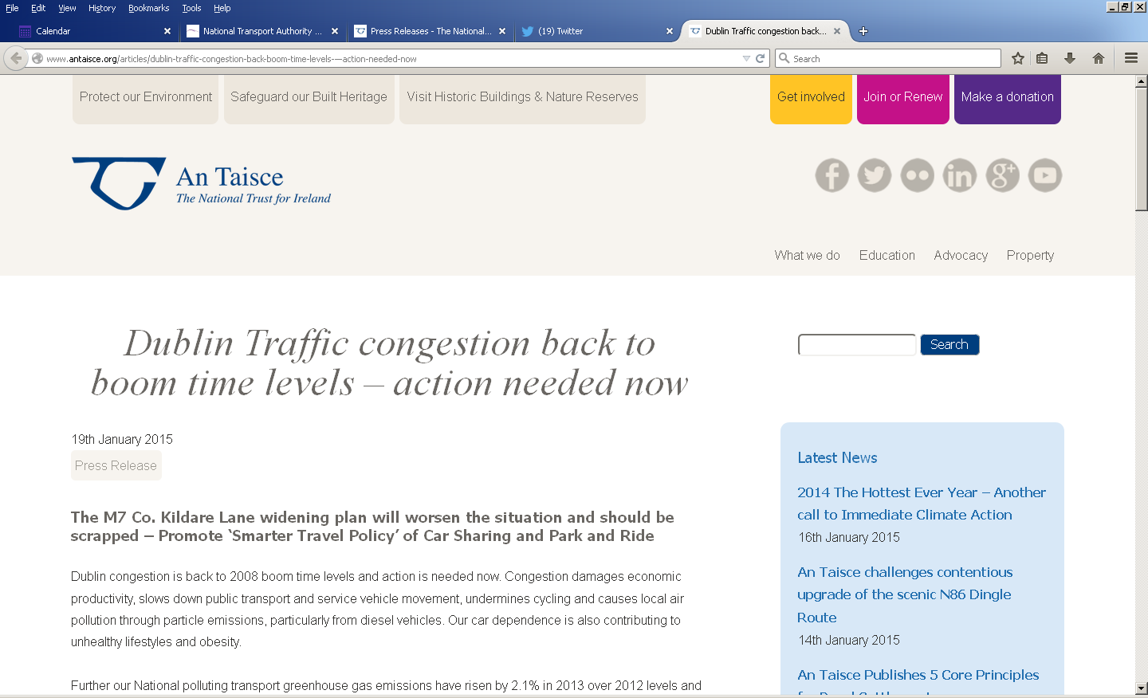
An Taisce press statement 19 Jan 2015…
TII Annual Average Daily Traffic flows (AADT) at M50 westlink:
2012: 110,000
2013 112,000
2014 117,000
2015 122,000

Slide 10
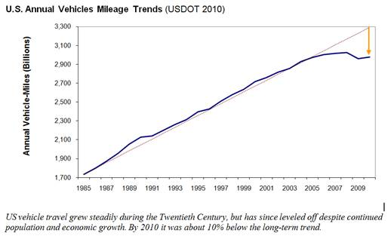
Evidence for Peak Car
“We probably shouldn’t spend billions on new roads until we are certain they are really needed”, Professor Phil Goodwin, UCL
Source: Todd Littmans’s Planetizen Blog, Victoria Public Transport Institute, 13/9/2012

Slide 11
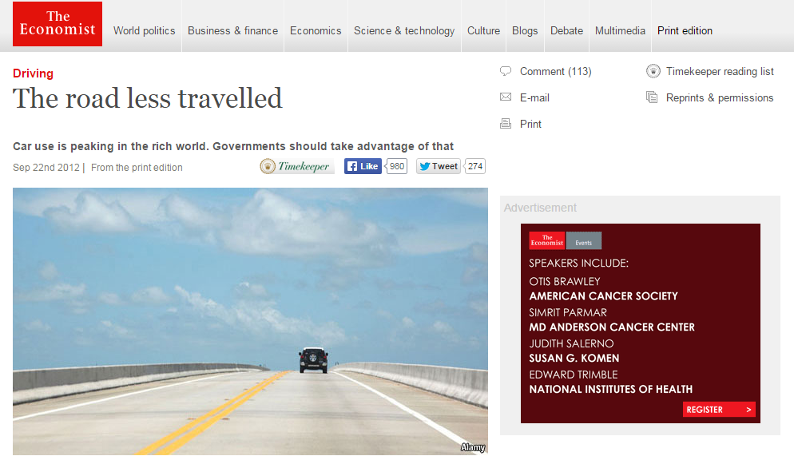
Peak car trends identified in: Australia, Belgium, France, Germany, Iceland, Japan, New Zealand, Sweden and the United Kingdom

Slide 12
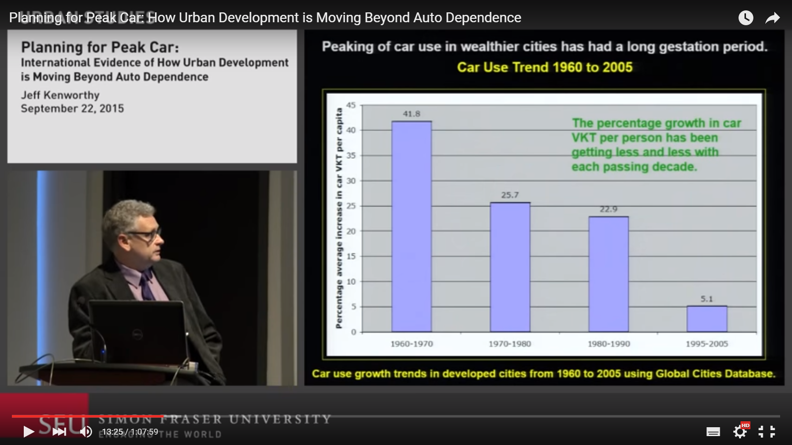
Evidence for Peak Car
“We probably shouldn’t spend billions on new roads until we are certain they are really needed”, Professor Phil Goodwin, UCL
SFU Kenworthy lecture (on 14)
https://www.youtube.com/watch?v=0cPbSqUig4A

Slide 13
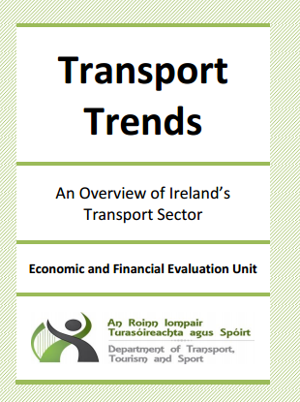
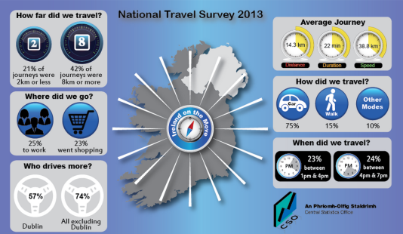
Irish Travel Behaviour
2013 NTA National Household Travel Survey
  Car 75% of all trips (80% outside of Dublin)
  Walk 15% of all trips
  Public Transport 6% of all trips
  Cycle 1% of all trips
  A profile of embedded automobile
  dependency and culture
Source: 2013 NTA National Household Travel Survey

Slide 14
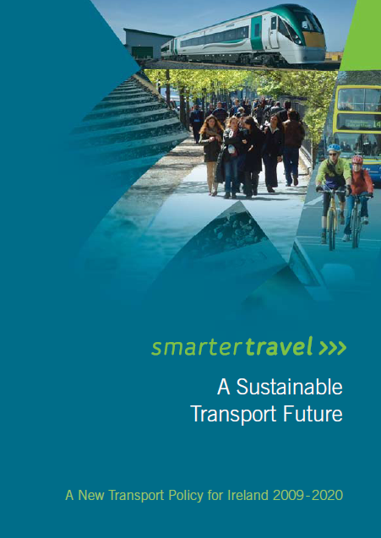
What is the Smarter Travel policy?
“Fundamental shift in travel culture to a sustainable transport system”
By 2020: -
  Car modal share 66% to 45%
  500 000 commuters to other forms of transport: walking, cycling P/T cycling, P/T
  Total car kms not to increase significantly
  Up to 8 Mts Emissions savings

Slide 15
What is the Smarter Travel policy?
4 Overarching aims: -
  Reducing the need to travel
  Providing alternatives to the car
  Improving fuel and energy efficiency
  New institutional arrangements
Smarter Travel Projects Fund
Smarter Travel Areas
  Changing hearts and minds…need to develop a local culture of smarter travel

Slide 16
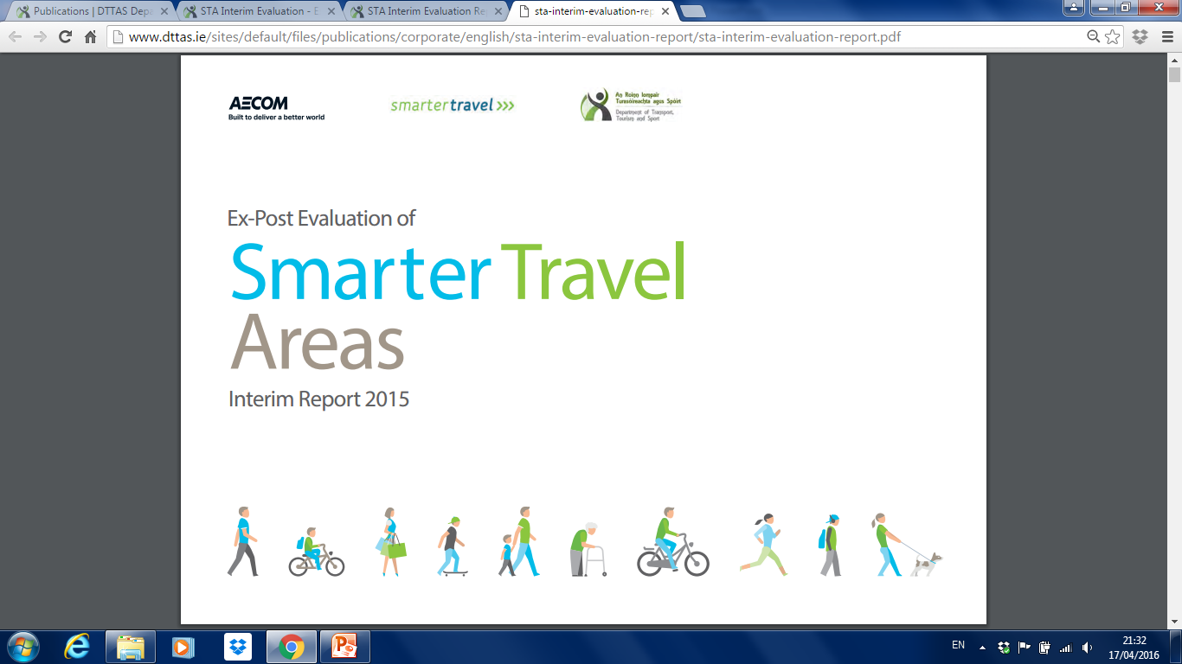
Smarter Travel Areas
Ex-post Evaluation of Smarter Travel Areas
  2015 interim study (60% of budget spent)
  Dungarvan (7.2m); Limerick (€9m); Westport (€5m)
  Marginal gains for walking and very marginal for cycling
  Biggest gains during peak periods
  Infrastructure accounting for 87%, 71% and 96% of spend to date respectively
  STA’s outperforming rest of country (excl. GDA) but RoI viewed as “disappointing”

Slide 17
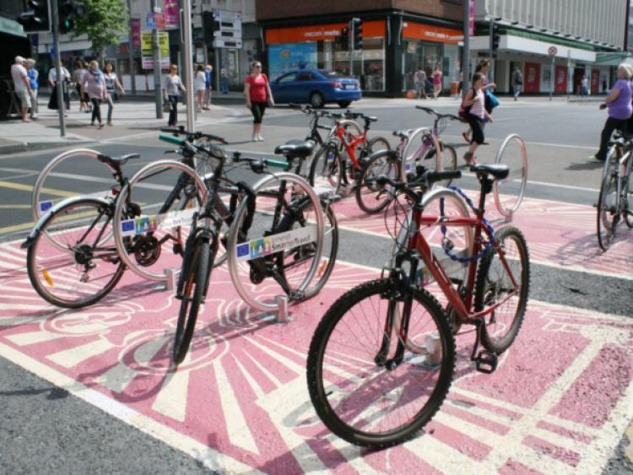
Smarter Travel Limerick

Slide 18
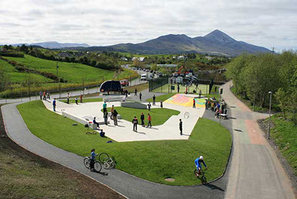
Smarter Travel Westport

Slide 19
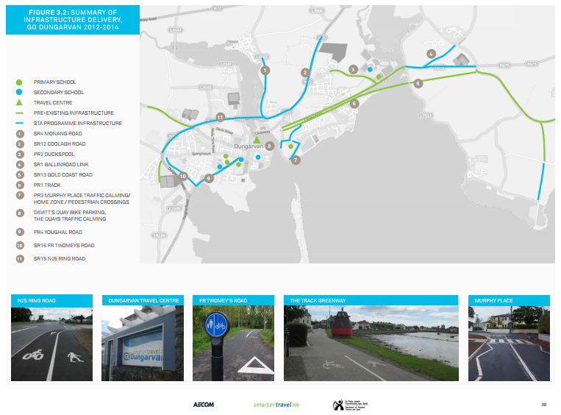
Smarter Travel Dungarvan

Slide 20
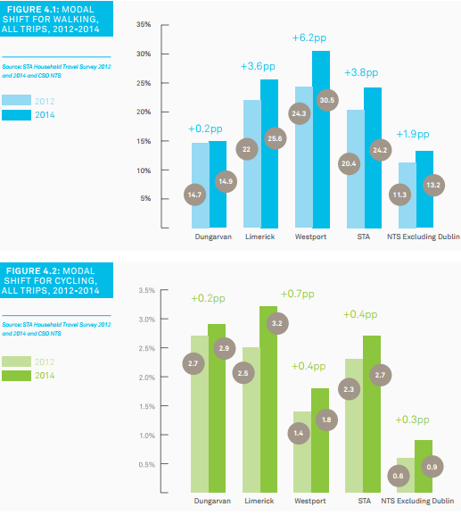
Smarter Travel Areas
Ex-post Evaluation of Smarter Travel Areas
  2015 interim study (60% of budget spent)
  Dungarvan (7.2m); Limerick (€9m); Westport (€5m)
  Marginal gains for walking and very marginal for cycling
  Biggest gains during peak periods
  Infrastructure accounting for 87%, 71% and 96% of spend to date respectively
  STA’s outperforming rest of country (excl. GDA) but RoI viewed as “disappointing”

Slide 21
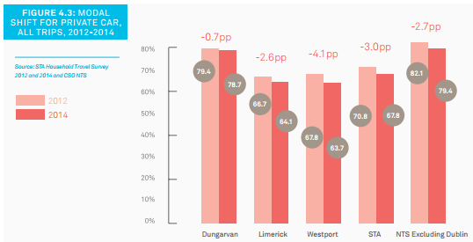
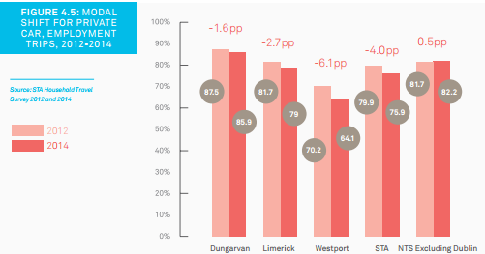
Smarter Travel Areas
Ex-post Evaluation of Smarter Travel Areas
  2015 interim study (60% of budget spent)
  Dungarvan (7.2m); Limerick (€9m); Westport (€5m)
  Marginal gains for walking and very marginal for cycling
  Biggest gains during peak periods
  Infrastructure accounting for 87%, 71% and 96% of spend to date respectively
  STA’s outperforming rest of country (excl. GDA) but RoI viewed as “disappointing”

Slide 22
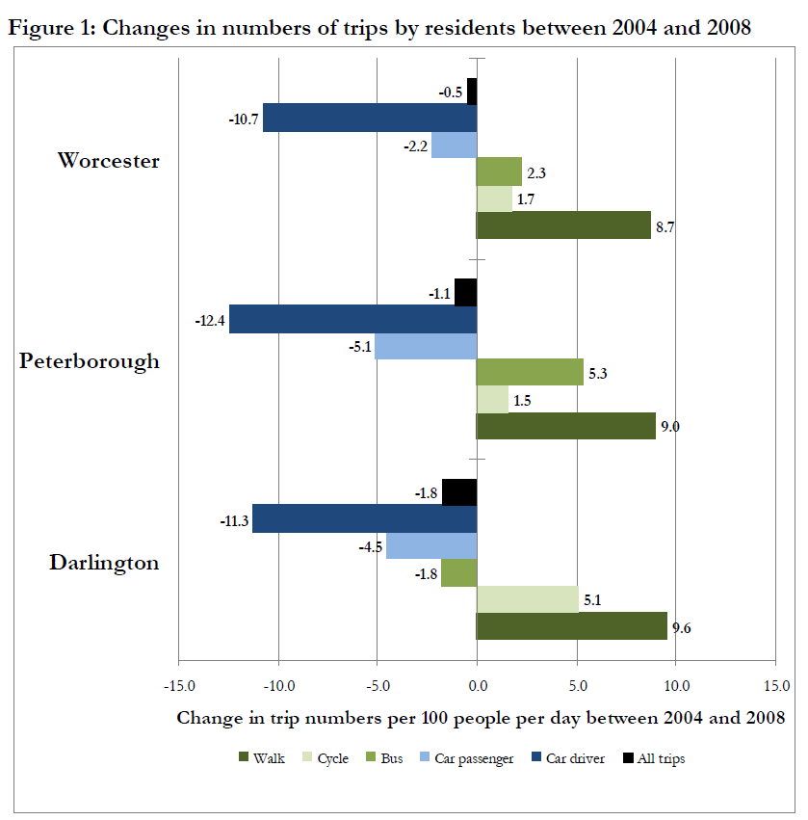
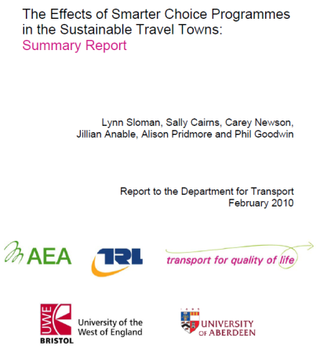
UK Sustainable Travel Towns

Slide 23
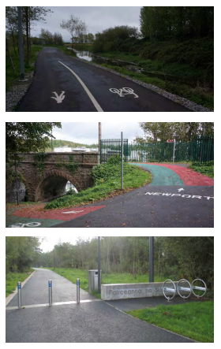
Smarter Travel Areas
Barriers to Modal Shift
  Poor perceptions of safety (#1)
  Low levels of cycling confidence
  Perception of walking/cycling as leisure pursuit
  “Inertia”
  Negative perceptions (“stigma”) of walking / cycling
  Weather and “practical concerns”
  Parental concerns
  “Dominant car culture”

Slide 24
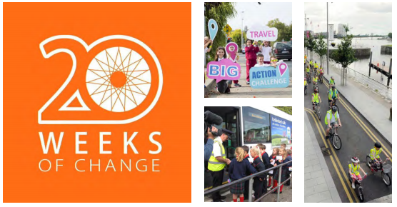
Smarter Travel Areas
Lessons learnt
  Programme development (identifying the right measures and how to approach them)
  Programme management (working with new disciplines)
  Infrastructure (community engagement / segregation of cycling infrastructure)
  Training in behavioural change techniques (e.g. an Taisce teams)

Slide 25
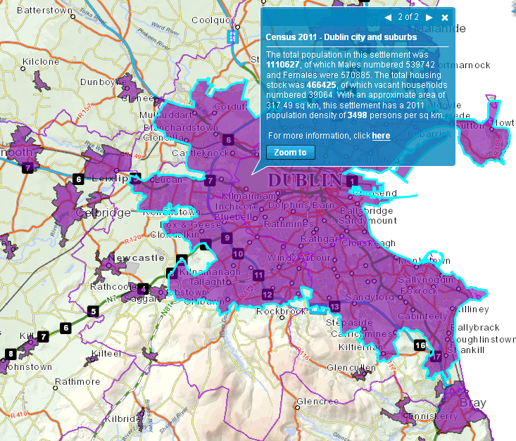
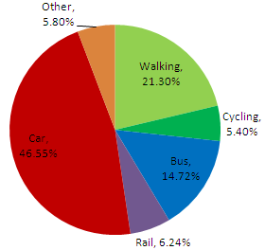
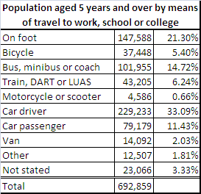
1. A high quality public transport network for Dublin city & suburbs
2009 National Travel Survey
http://census.cso.ie/sapmap/

Slide 26
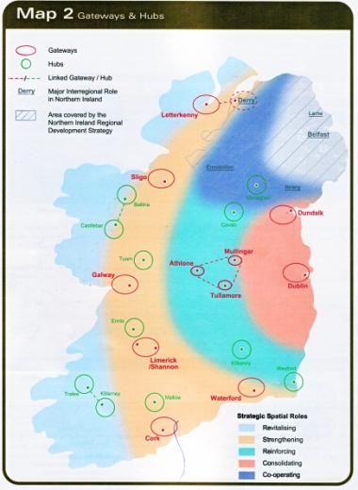
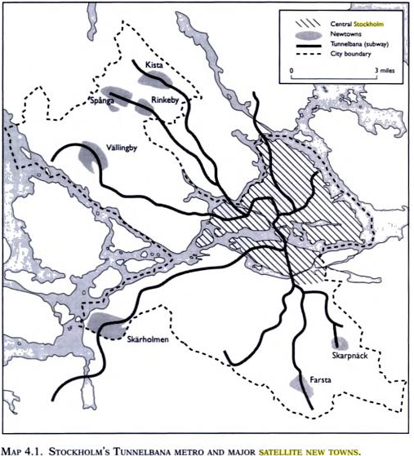
2. A regional public transport network for Dublin’s city-region
Into the Twenty-First Century I: GDA’s 30 large and medium-sized towns have more than doubled, from 197,593 to 412,751 (1986-2011), at a rate of 2.98% per annum compound.*
* Dr. Brian Hughes, arrow.dit.ie, 2014

Slide 27



3. Invest in behavioural change programs across towns & cities
Smarter Travel used as catch-all for: -
  Evidence for Behaviour change initiatives
  World-class programmes exist here
  Need to challenge “inertia”
  Imperative to survival

Slide 28
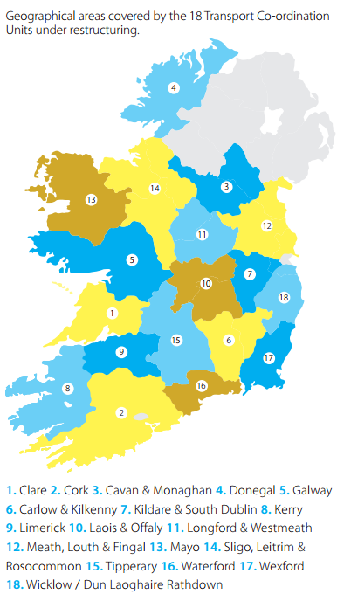

4. Protect and develop the rural transport sector
Local Integrated Transport Services
  From Pobal to NTA
  From 35 to 18 “Transport Coordination Units”
  Based within Local Authorities
  High social returns relative to costs

Slide 29
Things NPF can consider…
Reiterate the targets and values of the Smarter Travel Policy
  Climate change policy
  Plans & strategies
  Review mechanisms
  Accountability

Slide 30

Things NPF can consider…
Investment in behavioural change programming
  Evidence-base
  Knowledgebase
  Culture of inertia
  Transport & public health
There are no representatives from the built environment sector on the Healthy Ireland Council

Slide 31
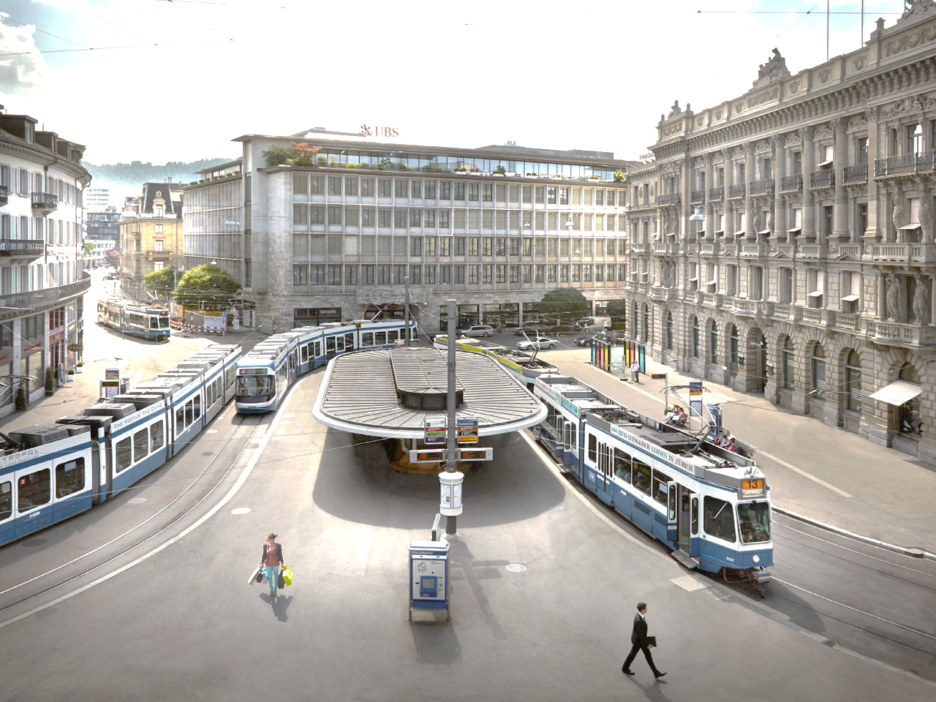
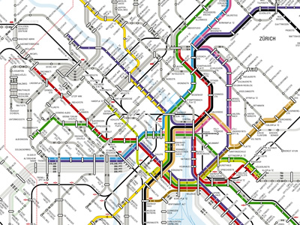
Be ambitious: we can do it
Zurich…
  Is not higher or denser
  Has no subway
  Is not poor
  50-60% mode share with near complete mobility

Slide 32
2016 Regional Studies Association Conference
NUIG Aras na Macleinn, 9th September 2016
Thank you
David O’Connor, DIT
david.oconnor@dit.ie
Notes:
32

