Slide 1
Ireland’s Next City
Dr Brian Hughes

Slide 2
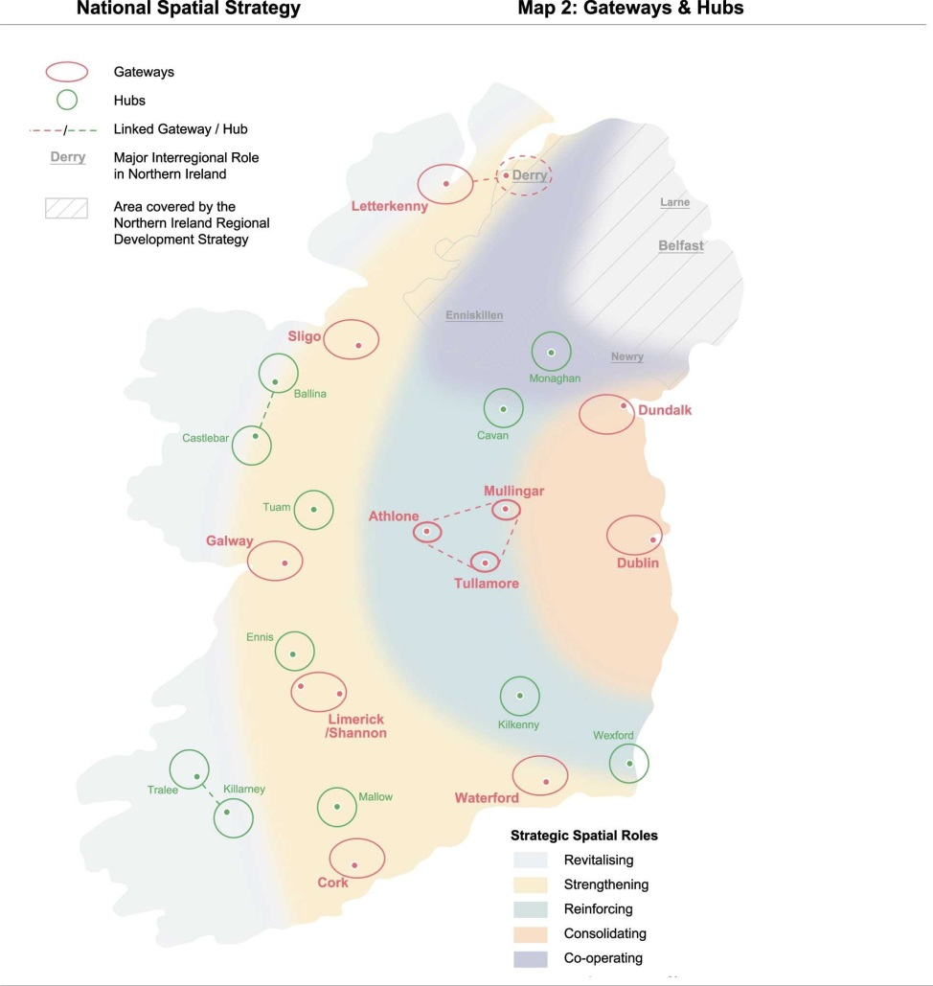
Census 2016
Census 2016 is throwing up some surprises some of which call into question the validity of the BRD approach for Ireland (Appendix 2).
Theory and evidence points to need to develop regional cities – if not, Dublin will do its own thing (Hughes, 2010).

Slide 3
Census 2016 Surprises?
1. We now have not 4, but 5 provinces (Table 1);
2. c.75% state pop growth = Dublin + Leinster (11);
3. State emigration <6k per annum = 28,558 (not 70k!);
4. Cities now growing faster than their surrounding areas;
5. Different parts of the country are showing huge and unexpected natural growth variations; and
6. East (4.68%) v. west (2.11%) growth rates show significant differentials (state 3.7%).

Slide 4
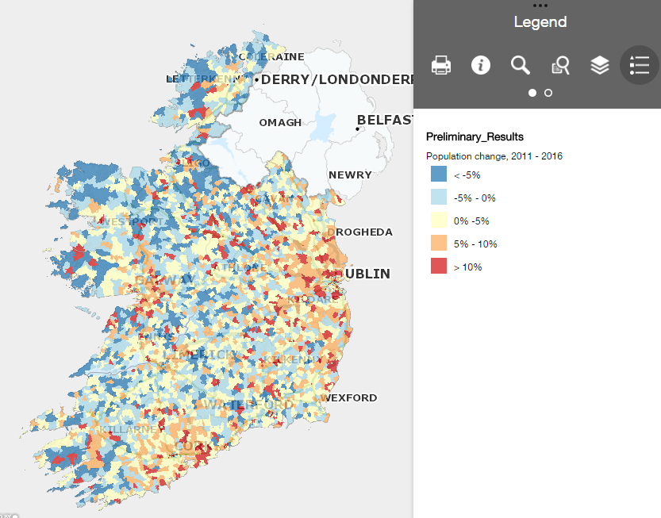

Slide 5
Lessons for strategic planning from Census 2016
We need a different approach/mindset.
For healthy regions, we need to grow (and put resources into) our provincial cities.
Need to accept essential nature of achieving critical mass.
23 was too many growth centres – fewer locations, and only winners, need to be chosen based on evidence.
How do we pick a winner?

Slide 6
Case study – picking a winner I: theoretical approach
Underlying premise/approach needs to be appropriate.
So, what’s appropriate for Ireland taking into account: sparse population; east v. west differential; our cross-border status; 1st city / 2nd city size difference?
Needs to be based on evidence, not politics.
Evidence is settlement growth.

Slide 7
Case study – picking a winner II: evidence
NSS selected Dundalk (including Blackrock, Co. Louth = c.37k) – Ireland’s second largest town – as the north-eastern gateway.
Drogheda was deemed a ‘service town’ to Dundalk.
However, Drogheda exc Laytown-Bettystown-Mornington (LBM: 35th largest town, 2011) was/is bigger (at c.38k) than Dundalk + Blackrock..!
Despite repeated evidence, danger is that again (NPF) reality of Drogheda’s size will be ignored in favour of Dundalk or Navan?
Nowhere else in Ireland do we have 2 x 10,000+ towns agglomerating side-by-side (Drogheda + LBM).
It would be negligent to ignore this reality in NPF.

Slide 8
Drogheda-LBM 2011 census Population Spread – OSI Map Grid References:

Slide 9
Drogheda-LBM 2016? census Population Spread – OSI Map Grid References:

Slide 10
Case study – picking a winner III: evaluation
Harmonised EU Measures (HEU):
Step 1: All grid cells with a density of more than 1,500 inhabitants per km² are selected.
Step 2: The contiguous high-density cells are then clustered, gaps are filled and only the clusters with a minimum population of 50,000 inhabitants are kept as an ‘urban center’.
Step 3: All the municipalities (local administrative units level 2 with at least half their population inside the urban center are selected as candidates to become part of the city.
Step 4: The city is defined ensuring that 1) there is a link to the political level, 2) that at least 50 % of the city population lives in an urban center and 3) that at least 75 % of the population of the urban center lives in a city.

Slide 11
Case study – picking a winner III: evaluation
Does the Drogheda v. Dundalk argument conform with the Harmonised EU Measures?
YES for Drogheda - NO for Dundalk
LESSONS?
Given the evidence, the NPF should confirm Drogheda as Ireland’s next city, 5th, replacing Waterford in population size.
This would complement Lisburn and Newry as cities in NI, strengthening the Dublin/Belfast Corridor.
Increasingly difficult to ignore statistical evidence: time for Ireland to adopt evidence-based policy rather than policy-based evidence..!

Slide 12
Thank you.
Dr Brian Hughes
Brian.Hughes@dit.ie

