Slide 1
Tailoring approaches to creative sector development in peripheral European regions
Dr. Aisling Murtagh
Dr. Patrick Collins
Whitaker Institute & School of Geography and Archaeology
National University of Ireland, Galway

Slide 2
Overview
a creative momentum project
Peripheral regional development issues
Re-thinking the periphery – moving beyond a problem centred focus
The creative sector in peripheral regions- learning from practice:
Craft and design in Akureyri, North East Iceland
A cooperation culture in Mid Sweden
Policy implications and the National Planning Framework
Further work

Slide 3
Creative Sector Index
Economic Impact Assessment
Supports Assessment & Project Evaluation
Business Model Toolkit
Legacy Planning
3 years
2015-2018
Builds on Creative Edge project (2011-2013)
Build evidence base for peripheral creative sector development
Register for updates at: www.mycreativeedge.eu

Slide 4
Transnational project across Europe’s northern edge

Slide 5
Development challenges in peripheral regions are many…
Lacking power
Erosion of human capital
Ageing population
Local market limited
Lacking innovation and entrepreneurship
Draw to the core (education, business opportunities, jobs)
Narrow industry sectors (predominantly service and primary industry)
Sources: Copus, 2001, Hall, 2007; Ehrlich, Kriszan and Lang, 2012, Kaufmann and Malul, 2014

Slide 6
A different view of the periphery
Periphery itself is an asset
Attracts people (tourism, lifestyle migrants)
Inspires products (culture, heritage, nature, landscape)
Entrepreneurs in periphery capitalise on strengths
Industrial and technological change
Impact of issues traditionally affecting peripheral regions is reducing
Economy is diversifying
Role of the creative sector
(Sources: Anderson, 2000; Copus 2001; Copus and Noguera, 2010; Mayer, Habersetzer and Meili, 2016)

Slide 7
Role of creative sector in periphery
Innovative sector with spillovers
Socially embedded e.g. craft, arts (Bertacchini and Borione; 2013; Bennett, McGuire and Rahman, 2015)
Stimluate growth in other sectors
Strategically develop cross-overs
Care not to over-value:
Rural creative entrepreneurs not growth oriented (Herslund, 2012)
What sectors are suited to the periphery? Impacts type of development
Job insecurity and issue of labour ecxhange (Dissart, 2003)

Slide 8
The creative and cultural sector A working structure…

Slide 9
Craft and Design entrepreneurs in Akureyri, Iceland
“Every item has a story”

Slide 10
Craft and Design entrepreneurs in Akureyri, Iceland

Slide 11
Craft and Design entrepreneurs in Akureyri, Iceland
Products with strong place attachment
Local, national and international suppliers and consumers
Tourism growth has provided boost

Slide 12
Implications for craft and design in peripheral regions
Play to strengths
Culture, heritage and nature a resource
Strong connection to peripheral place
‘aesthetic consumption’ (Anderson, 2000)
Don’t try to become the core, but stay connected
local, regional, national and international connections
Need for better economic integration in peripheral regions (Mayer, Habersetzer and Meili, 2016; Courtney et al.,2007)
local
rural-urban
Core –periphery

Slide 13
Cooperative culture in Mid-Sweden
Non profit organisation
8 members (design, craft, artisan food)
Retail outlet in Sundsvall
Exhibition space
Open to non members
Networks – production & consumption, enterpreneurs

Slide 14
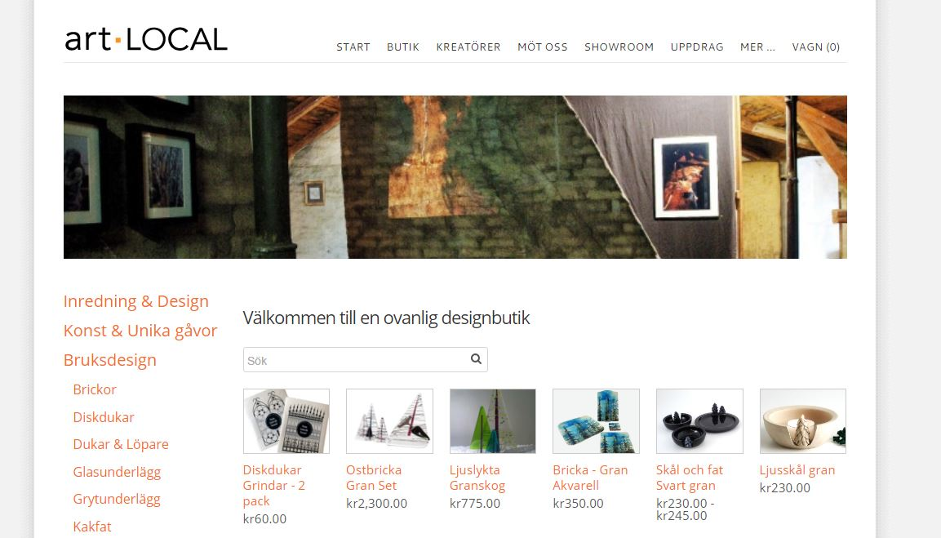
Cooperative culture in Mid-Sweden
Local art showroom in Sundsvall and online shop
Sustainable design
Local branding
DESIGN SUNDSVALL STENSTAD®
locally designed design based on Sundsvall's historic industrial history.

Slide 15
Implications for creative sector in peripheral regions
Helps overcome dislocation, builds networks, public visibility (placemaking)
Strengthen local economy interconnections (Mayer, Habersetzer and Meili, 2016; Courtney et al.,2007)
Target tourism, sustainable consumers – connected to wider market trends (not powerless & disconnected)
Similarly…play to strengths
Industrial heritage a resource - branding
Strong connection to peripheral place
‘aesthetic consumption’ (Anderson, 2000)

Slide 16
Policy implications
Vital importance of (creative)entrepreneurs to peripheral regions
Identify and capitalise on opportunities
Limited local markets – bring economic capital to the periphery
Operate in national and international markets
Connecting people
Connecting places - the periphery locally, regionally, nationally and globally Improve place image

Slide 17
The National Planning Framework and Ireland’s periphery
Long term thinking
economic development forecasts & regional economic development scenarios
Importance of rural based enterprise
Dynamic sectors - food, tourism, natural resource and innovation.
Also a role for the creative sector?
Develop critical infrastructure
Physical and social
Help address challenges identified:
Vacancy and under-utilisation of land within urban areas.
Life and work pushed further apart

Slide 18
Future work
Develop these and other case studies to further learning from practice
Explore how policy has impacted practice in the regions
Further evaluate the role of the creative sector in the periphery
What approach – one of two policy discourses?
technologically oriented creative sub-sectors
arts and cultural oriented creative sub-sectors
(Faggian et al.,2013)
What sectors?
Aim for job growth or greater social cohesion
Potential through related variety?
Additional economic growth occurs because of the presence of related, complementary sectors
Tourism (Bell and Jayne, 2010; Power, 2002)
Agri-tivity (Woodward and Bremner (2015)

Slide 19
Thank you

